Slide 1
Improving Data on Immigrant’s Legal Status
Jennifer Van Hook

Slide 2
If a tree falls in a forest and no one hears it, does it make a sound?

Slide 3
Light is better than shadows
“Only by ensuring that scientific data is never distorted or concealed to serve a political agenda, making scientific decisions based on facts, not ideology, and including the public in our decision-making process will we harness the power of science to achieve our goals.”
--Barack Obama, Sept. 4, 2012
Notes:
We now need information about immigrants’ by legal status in order to anticipate the costs and management of comprehensive immigration reform, and this information is not readily available.

Slide 4
Outline
Limitations of data on unauthorized immigrants
Methodological Advancements
Applications: MPI Data Hub

Slide 5
Acknowledgements
Collaborators:
James Bachmeier, Randy Capps, Michael Fix, Donna Coffman, Ofer Harel
Grants:
P01 HD062498 “The Mexican Children of Immigrants Program Project”
RC2 HD064497. “Generating Linked NCHS and OIS Data for Immigrant Health and Mortality Research ”
Department of Homeland Security (DHS)

Slide 6
How we know what we know
Residual Method
Surveys
Notes:
Because we haven’t – until recently – had demographic data on legal status, demographers have had to use indirect methods to estimate the size and characteristics of the unauthorized foreign born population.
The most common method is referred to as the residual method.

Slide 7
Residual Method
Unauthorized FB =
Total FB (Census) – Legal FB (Admin data)
Notes:
Because we haven’t – until recently – had demographic data on legal status, demographers have had to use indirect methods to estimate the size and characteristics of the unauthorized foreign born population.
The most common method is referred to as the residual method.

Slide 8
Notes:
Some of the unauthorized (maybe about 60%) entered without inspection—EWIs. Another fraction came to the United States legally (with a tourist, work, or student visa) but then subsequently violated the terms of their visa by over-staying or working illegally.

Slide 9
12 Million
11 Million
3 Million
2 Million
2 Million
Sources: Various reports by Passel, Woodrow, Bean, Van Hook, Hoefer, Rytina, Warren
Notes:
JENNY
Illegal immigration started to become noticeable in the 1970s. This chart shows the most reliable estimates of the number of unauthorized immigrants in the United States.
In the two decades between 1988 and 2008, we saw a steady increase of about half-a-million per year, reaching 12 million by 2008. This occurred despite increases in enforcement and deportations throughout the 1990s.

Slide 10
Limitations
Residual Method
Produces Aggregated estimates only
Surveys
How honest are people about their legal status?
Small sample sizes
Notes:
So you can see what relief it was to learn that some major surveys have added questions about legal status to their interview schedules.
SIPP legal status questions were not widely publicized and the data are under-utilized.

Slide 11
Are unauthorized migrants captured in official surveys?
YES
But they are not fully covered…

Slide 12
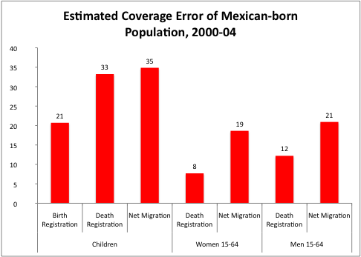

Slide 13
Do people answer questions about legal status?
Usually

Slide 14
Among all Foreign born:
Missing on Migration Status: 4.3%
Reported as Unauthorized: 26%

Slide 15
Do people tell the truth?
Mostly

Slide 16
 | SIPP Hot deck | SIPP logical imputation | Pew | DHS
Mexico | 51.6 | 56.1 | 56.0 | 57.0
Other LA | 20.3 | 21.5 | 22.0
Asia | 17.7 | 12.4 | 13.0
Europe/Canada | 6.1 | 7.5 | 6.0
Other | 4.3 | 2.5 | 3.0

Slide 17
New Methods for Using Survey Data
Cross-survey multiple imputation
Solves the small sample-size problem

Slide 18
Cross-survey multiple imputation
Small Survey (SIPP)
Unauthorized Status
Common variables
Big Survey (Census)
?
Common variables
Unauthorized Status (imputed)
Notes:
Another method is statistical imputation. Statistical imputations use the associations between a set of predictors and unauthorized status from a survey that includes questions about immigrants’ legal status (the donor sample) to assign legal status to foreign-born respondents in surveys lacking such measures (the target sample). Statistical imputations have employed both “single” and “multiple” equation approaches as the basis for prediction.

Slide 19
MPI Data Hub

