Slide 2
Legal Disclaimer
This town hall is designed to provide community members basic information about COVID-19 and immigration. It is not a substitute for legal advice.

Slide 3
About the Center for Immigrants’ Rights Clinic

Slide 4
Purpose & Roadmap
Immigration Services
Immigration Enforcement & Detention
Immigration Courts
Borders
U.S. consulates and embassies
International Students
Public Benefits and Food Security
Resources
Q & A

Slide 5
Immigration Services
Which USCIS offices are closed?
What if I had a green card interview or an affirmative asylum interview scheduled in person during the time the USCIS office is closed?
What if I had a biometrics (fingerprinting) appointment scheduled during the time that offices are closed?
What about DACA?
What if I am a nonimmigrant (i.e., students, business visitors) and my status is set to expire before I can leave the United States?
Source: https://www.uscis.gov/about-us/uscis-response-coronavirus-2019-covid-19.

Slide 6
Immigration Enforcement
Will the DHS conduct immigration enforcement at schools? Hospitals?
Sensitive Locations Policy (2011)
ICE Guidance on COVID-19 (March 18, 2020)
Should I be worried about immigration enforcement around the State College Area School District?
→ FAQ on Sensitive Locations → ICE Guidance on COVID-19 (March 18, 2020)
Will ICE conduct arrests during COVID-19?

Slide 7
Will ICE conduct arrests during COVID-19?
Source: ICE Guidance on COVID-19 (2020) https://www.ice.gov/coronavirus

Slide 8
ICE Guidance on COVID-19
“Consistent with its sensitive locations policy, during the COVID-19 crisis, ICE will not carry out enforcement operations at or near health care facilities, such as hospitals, doctors' offices, accredited health clinics, and emergent or urgent care facilities, except in the most extraordinary of circumstances. Individuals should not avoid seeking medical care because they fear civil immigration enforcement.” (emphasis added).
Source: https://www.ice.gov/coronavirus

Slide 9
State College Borough Resolution 1180 (2016)
WHEREAS, all people present in the Borough of State College “are members of the State College community and will be treated fairly and equitably; and [ . . . .] that the State College Council will not voluntarily assist in any efforts by the federal government to apprehend, detain or deport community members.”
Borough Resolution 1180 (2016) https://www.statecollegepa.us/DocumentCenter/View/17545/RES-1180---A-Resolution-on-Immigration-Enforcement
Notes:
4/14/20

Slide 10
Anti-Bias Based Policing and Immigration Policy of the State College Police Department (2017)
The policy outlines standards as it relates to bias based policing and immigration. The policy encourages noncitizens to utilize police services and states that as a general practice, the State College Police do not ask or collect information about immigration status, nor does it report noncitizens to the federal government, except as necessary to an ongoing criminal investigation. The policy also outlines two types of immigration remedies available to victims and the specific role of law enforcement.

Slide 11
Immigration Detention: Is ICE Still Detaining Immigrants?
Yes, but with focus on those who are a public-safety risk and/or subject to mandatory detention on criminal grounds
Otherwise, ICE will exercise discretion to delay enforcement
ICE released nearly 700 people after a case by case evaluation
Over 35,000 immigrants remain in detention
Source: www.ice.gov/coronavirus; https://www.buzzfeednews.com/article/hamedaleaziz/immigrant-detainees-coronavirus-risk-early-release

Slide 12
Where is ICE Detaining in PA?
York County Prison
Pike County Correctional Facility
Clinton County Correctional Facility
Berks County Residential Center
Family detention
ICE spokesperson has said ICE will stop detaining new families in Berks. Source: why.org/articles/lawsuit-ice-family-detention-in-pa-is-a-tinderbox-due-to-covid-19

Slide 13
Has Anyone Detained in PA in Immigration Custody Tested Positive for COVID-19?
1 detainee in York County Prison
6 detainees in Pike County Correctional Facility
25 confirmed cases among ICE employees working in detention facilities, but none in PA
Source: www.ice.gov/coronavirus (current as of April 15, 2020)

Slide 14
What are the ways a detained immigrant can seek release?
Immigrants can still pay bond in certain locations
Source: www.ice.gov/coronavirus
Multiple lawsuits demanding release of adult families in immigration detention on due process and statutory grounds

Slide 15
Immigration Courts

Slide 16
Borders
How is the pandemic affecting travelers to the United States from around the world?
What are the changes at the U.S.-MX/U.S.-CA borders?
How are asylum seekers at the border impacted?

Slide 17
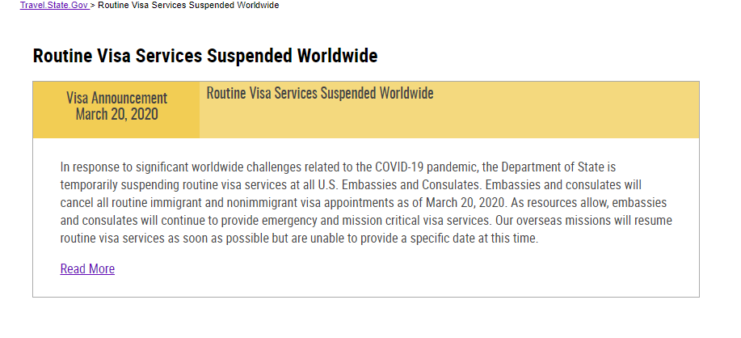
Consulates and Embassies: From the Department of State
Source: https://travel.state.gov/content/travel/en/News/visas-news/suspension-of-routine-visa-services.html

Slide 18
International Students
Will remote learning affect my immigration status?
Can I go back to my home country during remote instruction?
I am graduating in May, but I am having trouble obtaining a flight home or there are travel restrictions to return to my home country. What do I do if I can’t leave before the end of my 60-day grace period?
Spring 2020 is my last semester. Will I be able to return to the United States for OPT?
Source: Penn State Office of Global Programs https://global.psu.edu/covidintlfaq

Slide 19
Public Benefits and Food Security
How does the COVID-19 affect immigrant farmworkers and food chain workers?
If an immigrant has been laid off and needs food, should they worry about applying for services at the food pantry?
If an immigrant seeks testing or treatment for COVID-19, will that count against them according to the Public Charge Rule?

Slide 20
CARES Act and Immigration
Are immigrants eligible for the economic stimulus payments included in the CARES Act?
Are stimulus payments counted in the “public charge” test?

Slide 21
Resources
Center for Immigrants’ Rights Clinic: https://pennstatelaw.psu.edu/immigration-time-of-trump
PSU Office of Global Programs: https://global.psu.edu/covidintlfaq
Immigration Services: https://www.uscis.gov/about-us/uscis-response-covid-19
Immigration Enforcement: https://www.ice.gov/coronavirus
Immigration Courts: https://www.justice.gov/eoir/file/1259226/download
Visas and Consulates: https://travel.state.gov/content/travel/en/us-visas.html

