Slide 1
September 19, 2019
Bar Exam Workshop
Overview
MPRE
Disability accommodations
Important websites
Bar exam content and preparation
How to choose a state if your job plans are uncertain
Forms and requirements (how to get them, what to do with them)
Character & Fitness Process
How to pay bar review costs and bar fees
Your questions

Slide 2
Overview of Bar Admission
Admission to the bar is conducted through the Board of Bar Examiners of the state in which you are applying. While the admission process may vary significantly from state to state, the process usually involves:
Applying to sit for the Multistate Professional Responsibility Examination (MPRE) and taking the MPRE
Applying to sit for the Bar Exam and taking the Bar Exam
Completing your state’s character and fitness process and any additional admission prerequisites that may be required
For LL.M. students, make sure that you are eligible to take that state’s Bar Exam and file the requisite evaluation request (such as the Online Foreign Evaluation required by the New York State Board of Law Examiners) and designated official documents sufficiently in advance of the applicable Bar Exam date.

Slide 3
MPRE
What is the MPRE?
The Multistate Professional Responsibility Exam (MPRE) is required for admission to the bars of all US jurisdictions, except Wisconsin and Puerto Rico. The MPRE is based on the law governing the conduct of lawyers. It consists of 60 multiple-choice questions and takes approximately two hours to complete. The examination is administered three times per year (March, August, and November).
Currently, the MPRE is a paper-based exam, but the test is being transitioned to a computer-based exam, starting with the August 2019 exam with full transition completed by the March 2020 exam (see more information here); the question format, content and scoring will remain the same throughout the transition.
Please note that some jurisdictions, such as Massachusetts, require a passing score on file before you are allowed to apply for the bar exam. Other jurisdictions, such as Kansas and Kentucky, require a passing score before you are allowed to sit for the bar exam. Please check with your state bar association, particularly if you are considering waiting until March to take the MPRE.
Unlike for the bar exam, students do not have to take the MPRE in the jurisdiction where they plan to practice.
Registering and Preparing for the MPRE
The MPRE early registration deadline is often more than a month before the actual exam. Register early to get your preferred test location and to avoid paying a late fee.
Most students take a prep course offered by one of the various Bar Review companies or rely on the practice materials available at the MPRE website.

Slide 4
MPRE Accommodations
How to Apply for MPRE Test Accommodations
IMPORTANT: The process for requesting MPRE test accommodations will change for 2020: candidates will be required to apply for accommodations prior to registering for the MPRE. NCBE will begin accepting requests for accommodations for the March 2020 MPRE on October 21, 2019. These pages will be updated on October 1, 2019, with more information about the new process.

Slide 5
Bar Information for Applicants with Disabilities
Bar Information for Applicants with Disabilities
The directory contains information regarding:
The process for seeking bar examination accommodations for each state, including links to forms, deadlines, and additional information about the bar application process, and sample cases; and
Information about each state’s character and fitness inquiry, including links to forms, rules, and sample cases.

Slide 6
Some (not all) Important Websites
Because the processes vary by state, you will not receive emails from PSL about upcoming deadlines, but there are a number of resources available to help you navigate the process.
National Conference of Bar Examiners
http://www.ncbex.org/
Provides a list of bar admission requirements by state and links to the official state sites.
Pennsylvania Board of Law Examiners
http://www.pabarexam.org/
New York Board of Law Examiners
https://www.nybarexam.org/
Florida Board of Bar Examiners
https://www.floridabarexam.org/
California Board of Law Examiners
http://www.calbar.ca.gov/

Slide 7
Begin your search by visiting the NCBEX site, which contains information about deadlines and requirements for different jurisdictions. It is important that you routinely check your state’s Bar page, as deadlines and requirements change throughout the year and the state committees are not flexible about waiving requirements.

Slide 8
Upcoming Test Dates
February 25 - 26, 2020
July 28 - 29, 2020
Beware: Some jurisdictions may test over a 3-day period (e.g., Delaware: July 27, 28, and 29th)
Application deadlines: NOT UNIFORM

Slide 9
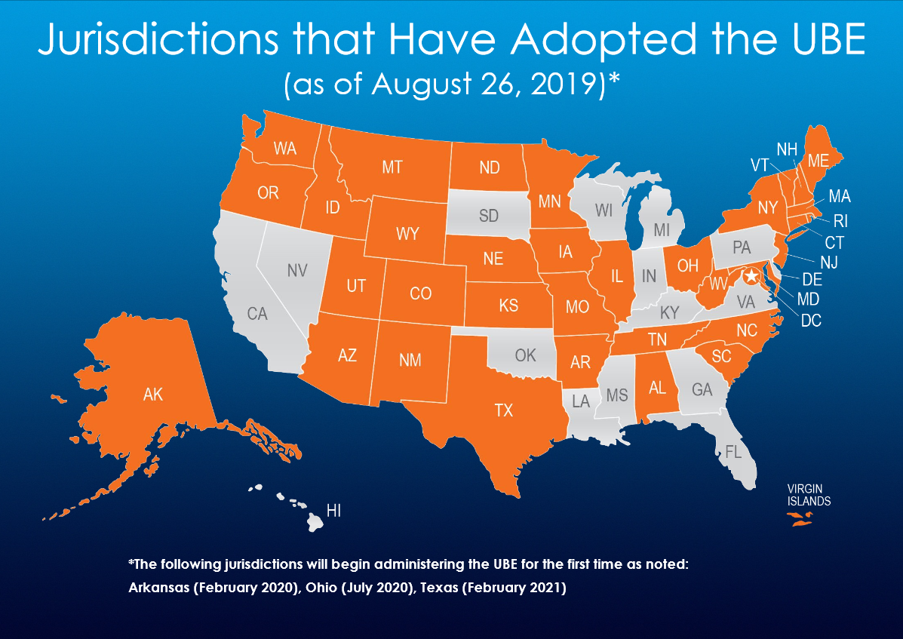

Slide 10
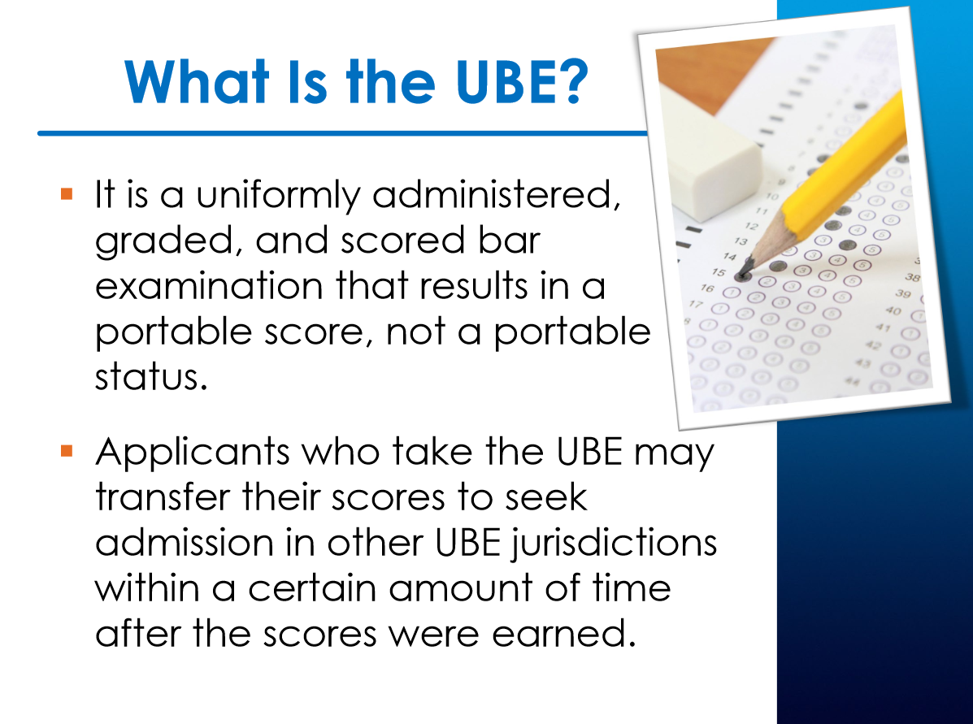

Slide 11
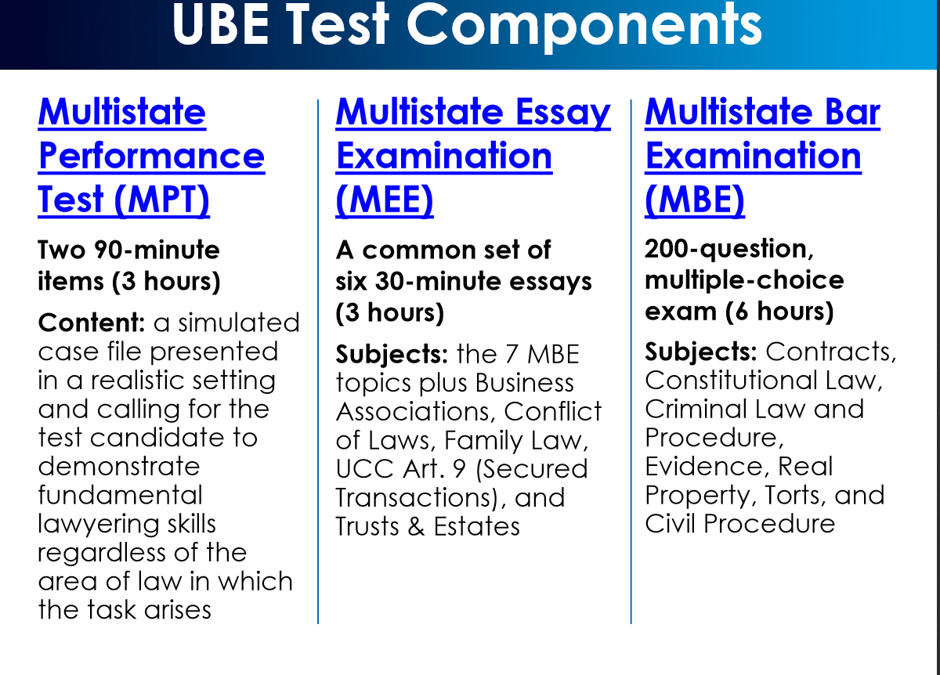

Slide 12
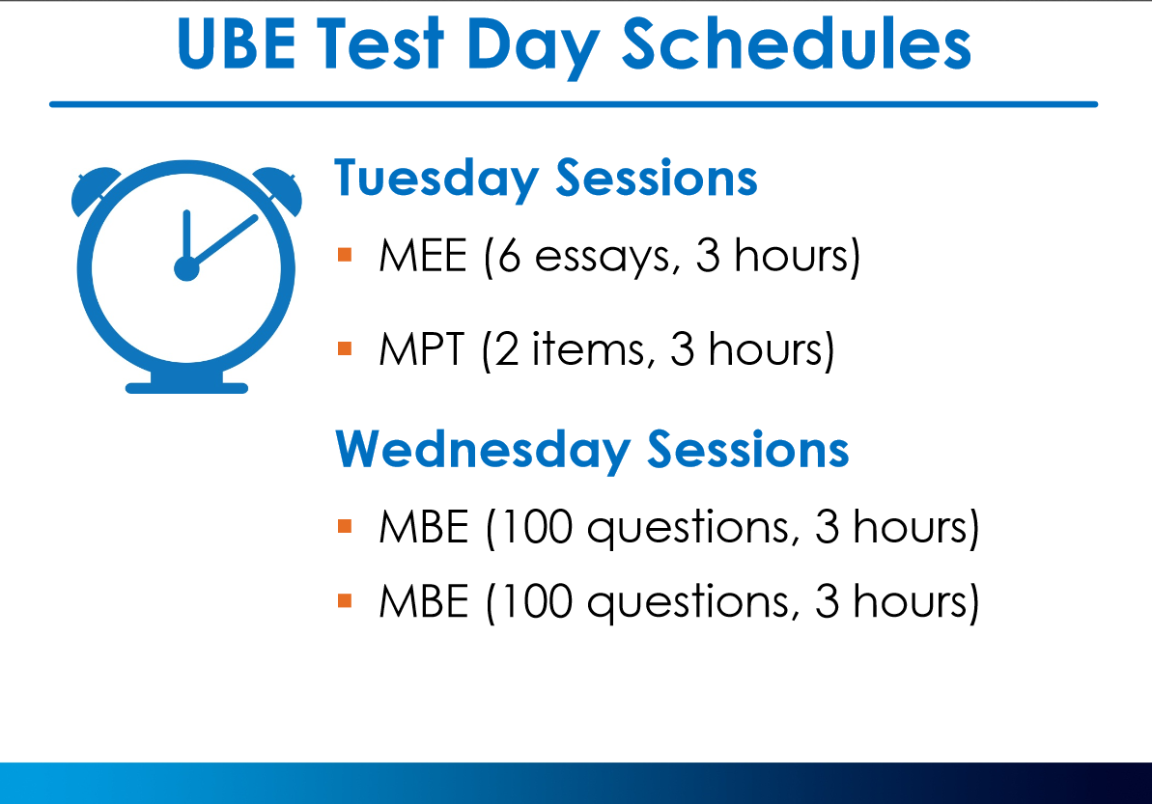

Slide 13
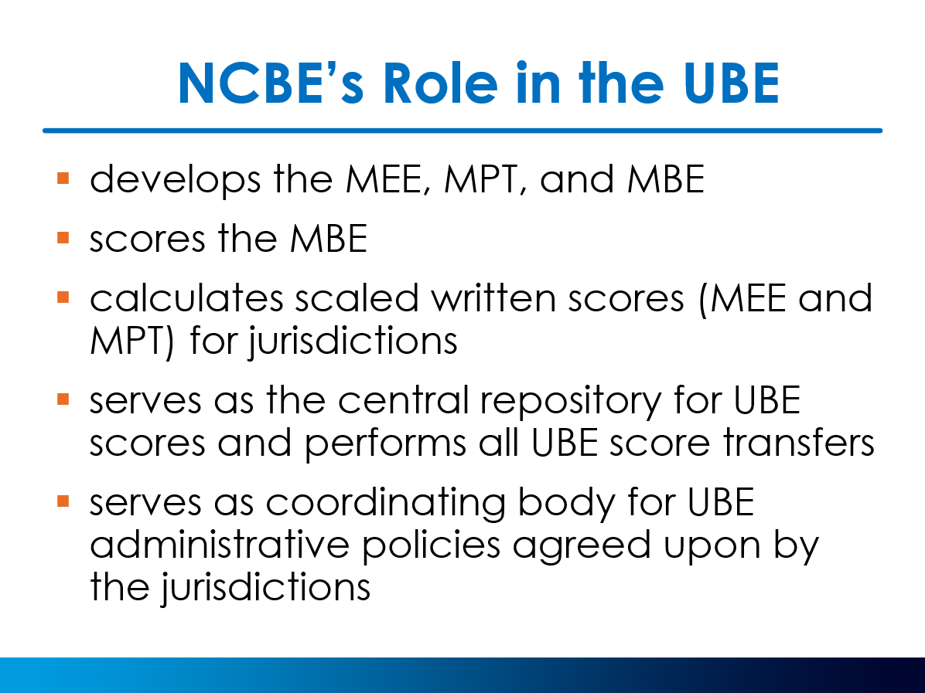

Slide 14
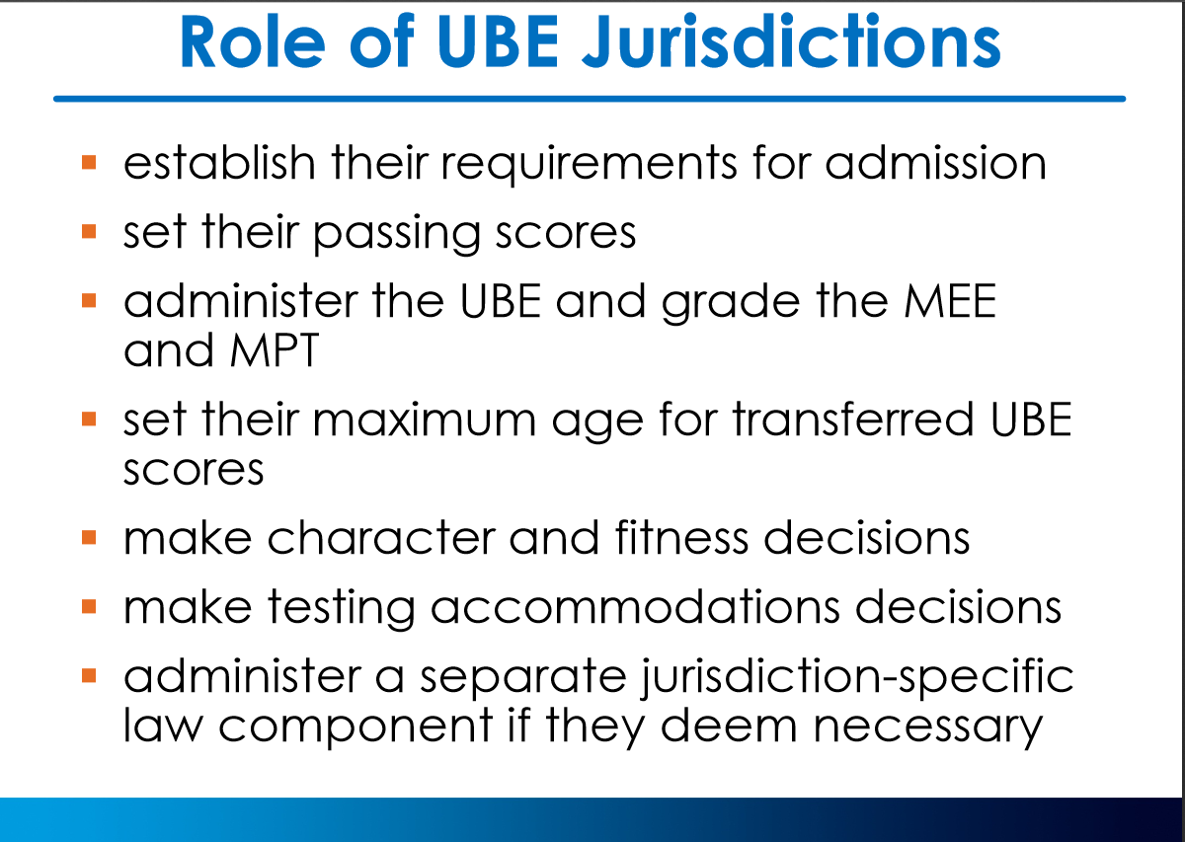

Slide 15
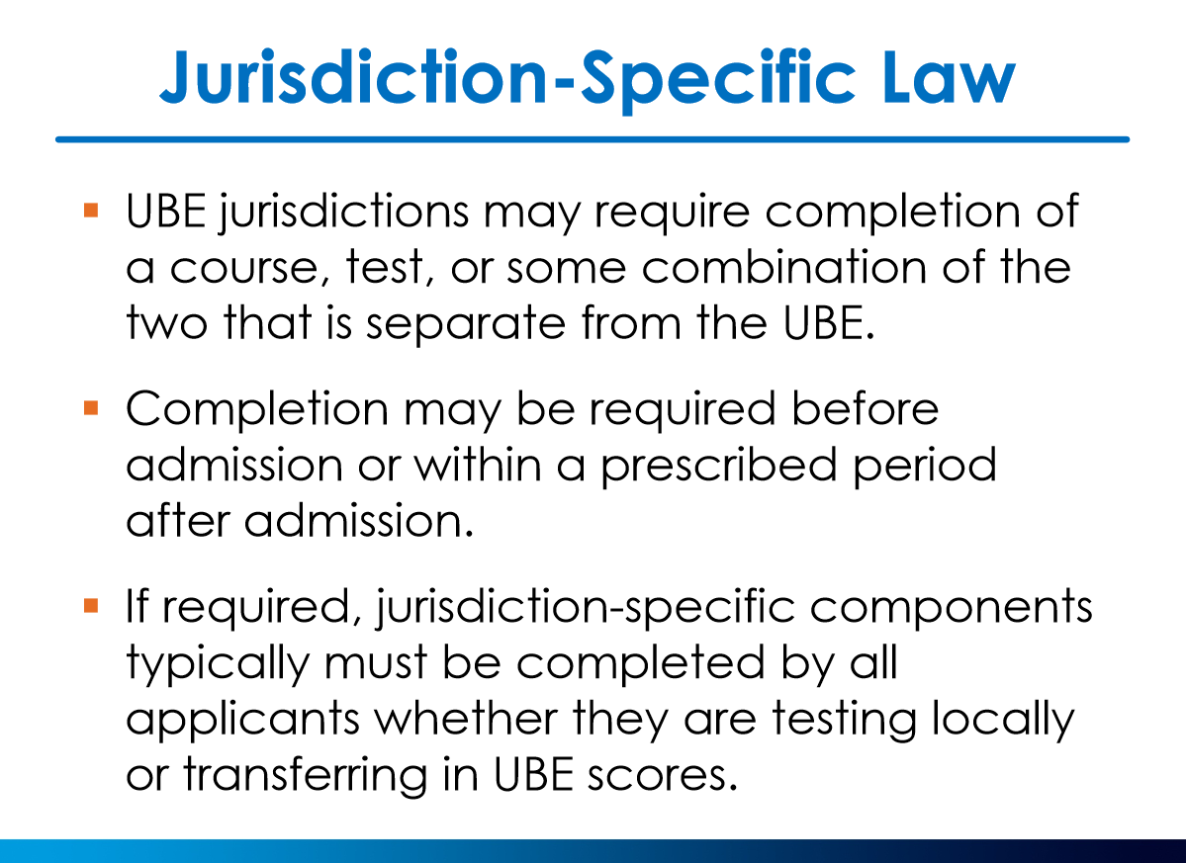

Slide 16
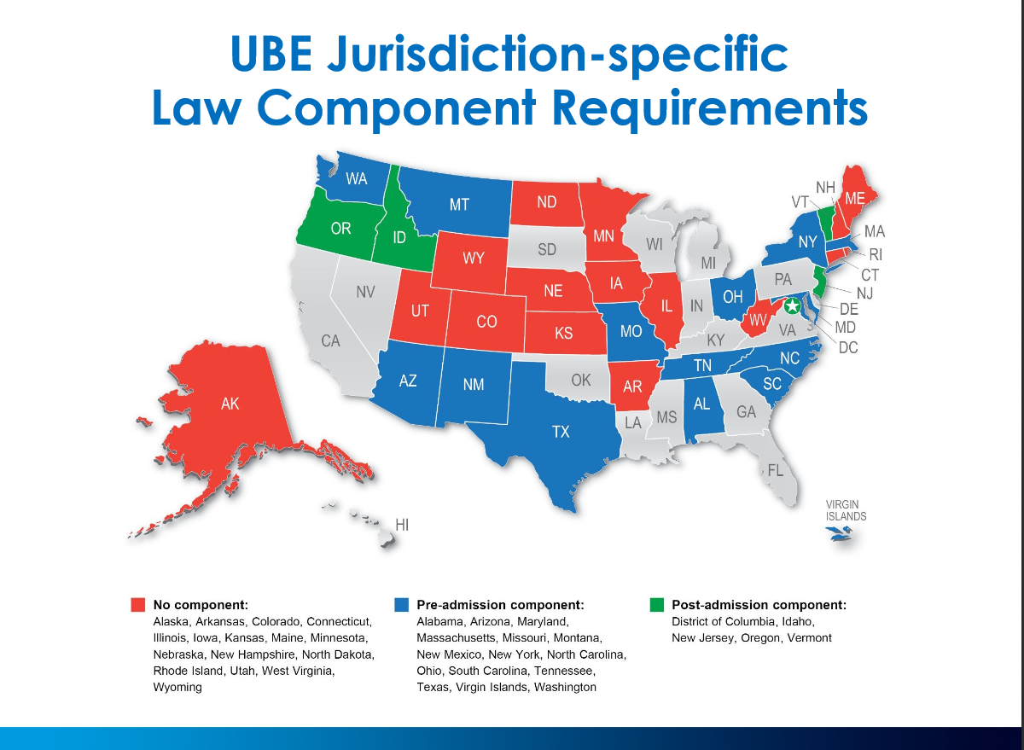

Slide 17
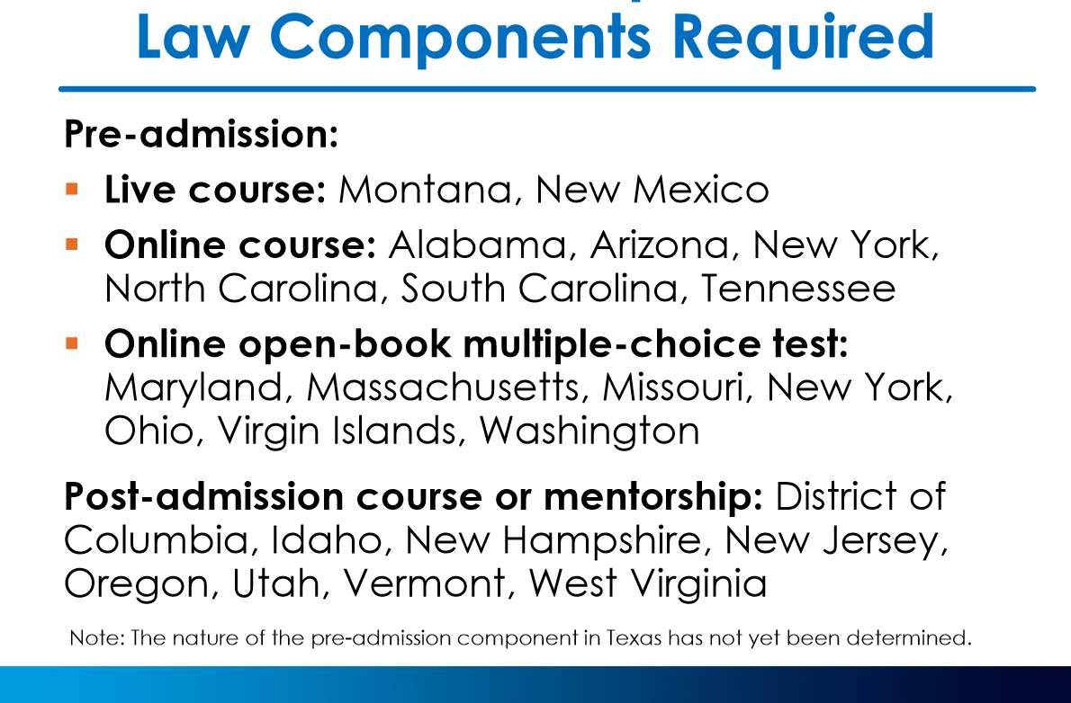

Slide 18
PA Bar Exam Tests and Topics Tested
ESSAY EXAMINATION: The essay examination consists of six essay questions that cover one or more of the following subjects:
Business Organizations (including corporations, partnerships, limited liability companies and professional corporations); Civil Procedure (Pennsylvania and federal) ; Conflict of Laws; Contracts; Criminal Law (including related Pennsylvania and federal constitutional issues and DUI); Employment Discrimination (limited to Title VII, ADA and ADEA); Evidence (Pennsylvania and federal); Family Law; Federal Constitutional Law; Federal Income Taxes (personal only and limited to taxable and non-taxable income, deductions, proprietorships and capital transactions); Professional Responsibility; Real Property; Torts; U.C.C., Art. II – Sales; Wills, Trusts and Decedents' Estates (including related fiduciary responsibilities)

Slide 19
PERFORMANCE TEST: By Order of the Supreme Court of Pennsylvania, one Performance Test (PT) question, developed by the Board, may be used in lieu of a Multistate Performance Test question as a component of the essay portion of the bar examination. The Performance Test (PT) is intended to test an applicant’s ability to use basic skills that a lawyer should possess to perform a task that a newly admitted attorney would be expected to perform. The PT is designed to test an applicant’s ability to perform the task that has been assigned using the factual information contained in a File and the legal principles that are provided in a Library.

Slide 20
Forms and requirements (how to get them, what to do with them)
Character & Fitness Process
http://www.pabarexam.org/
http://www.ncbex.org/

Slide 21
Bar Application Character And Fitness
Every jurisdiction investigates bar applicants. It is either done by the state bar association or in conjunction with the National Council of Bar Examiners. The investigation is a comprehensive inquiry into your background requiring you to disclose information about your personal and professional life. The information you provide will be supplemented by the investigation conducted by NCBEX or your bar.
Bar Application Background Investigation
Accuracy Is Critical For Bar Applicants
Character and Fitness FAQ's

Slide 22
Since jurisdiction rules and policies change, you are strongly advised to consult the jurisdiction’s bar admission agency directly for the most current information.
We expect each student to take responsibility for researching the exam requirements and application process for the jurisdiction in which he/she plans to apply for admission. We urge students to pay careful attention to deadlines and to fully research the overall application process in his/her preferred jurisdiction.

