Slide 1
“Trans-Pacific Lessons for Sports Leagues: What Americans and Australians Can Learn From Each Other”
Stephen F. Ross
Professor of Law/ Director of Institute for Sports Law, Policy and Research
The Pennsylvania State University
12 August 2013

Slide 2
Understanding Context
The National Football League is unique
History matters
Melbourne-based AFL clubs
Sydney-based NRL clubs
Size matters
Pressures for new teams, tax subsidies, relocation pressures
Labor markets: “add a zero”

Slide 3
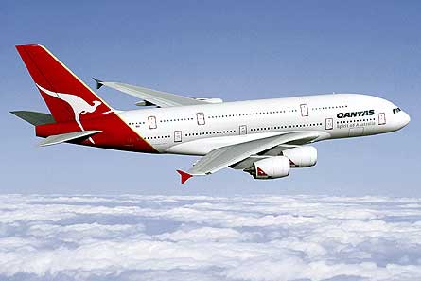
Westerlies
Non-elite participation
“Vertical separation” in club sports competitions
Conflict-free governance
Development programs for young players

Slide 4
Easterlies
Reasonably clear competition law
Agreements that have a non-trivial effect on competition (contrast how unrestrained market would be) must be justified
Leagues must have a legitimate, pro-competitive purpose
Rules must not be overly restrictive
Parity not necessarily desirable
Revenue sharing to maximize league goals
Central revenue not pro rata but designed to give clubs incentives for efficient operation
Local revenue subject to redistribution

Slide 5
Common Issues
Designing salary caps and free agent rules to maximize fan appeal
Franchise relocation accounting for tradition but also optimal TV growth
Growing the game internationally

Slide 6
Q&A

