Slide 1
Immigration and Racial/Ethnic Diversity in the United States

Slide 2
Immigration US Trends
Notes:
JENNY
Source: Department of Homeland Security. 2010. Yearbook of Immigration Statistics: 2009, Tables 1 and 2. (http://www.dhs.gov/files/statistics/publications/LPR09.shtm).
Immigration not only drives population growth in the United States, but it is also generates racial and ethnic diversity.
Before the 1960s, most immigrants came from Europe or Canada. The Irish and Germans dominated, each group making up about one-quarter to one-third of all foreign-born. But now, only 12% of immigrants come from Europe or Canada.

Slide 3
Immigration US Trends
Notes:
JENNY
Now, 40% of legal immigrants come from Latin America. About 15% come from Mexico alone.

Slide 4
Immigration US Trends
Notes:
JENNY
Another 35% come from Asia, chiefly countries like China, the Philippines, Vietnam, and India.

Slide 5
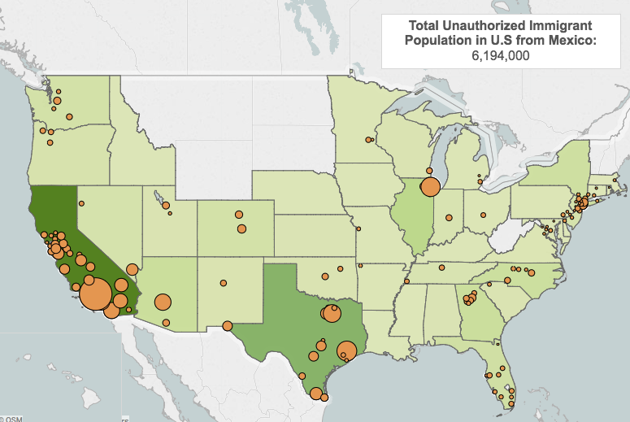

Slide 6
Racial and Ethnic Diversity

Slide 7
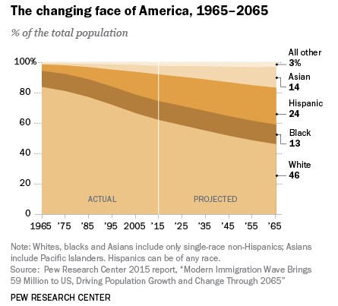

Slide 8
Regional Differences

Slide 9
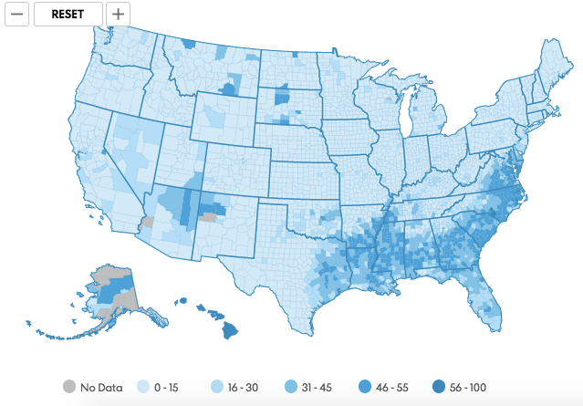
Diversity 1960 (http://www.usatoday.com/story/news/nation/2014/10/21/diversity-map/17657485/)
Notes:
Diversity index = probability that two persons drawn at random belong to different groups.

Slide 10
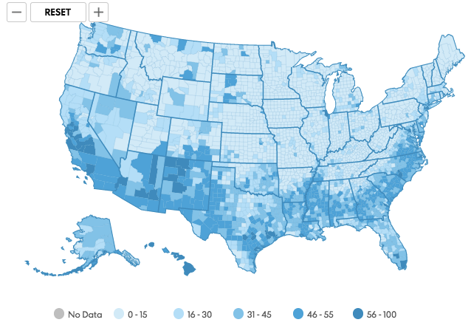
Diversity 1990 (http://www.usatoday.com/story/news/nation/2014/10/21/diversity-map/17657485/)

Slide 11
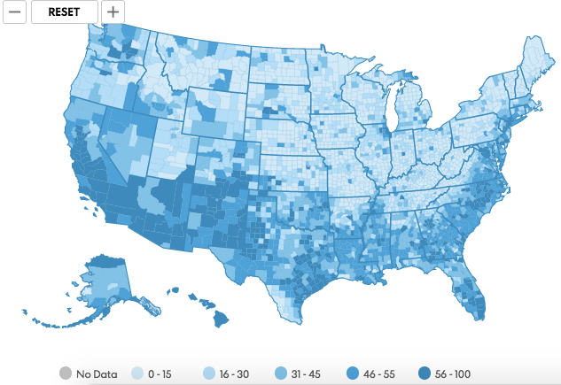
Diversity 2010 (http://www.usatoday.com/story/news/nation/2014/10/21/diversity-map/17657485/)

Slide 12
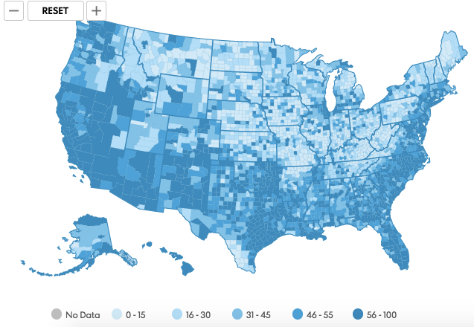
Diversity 2050 (http://www.usatoday.com/story/news/nation/2014/10/21/diversity-map/17657485/)

Slide 13
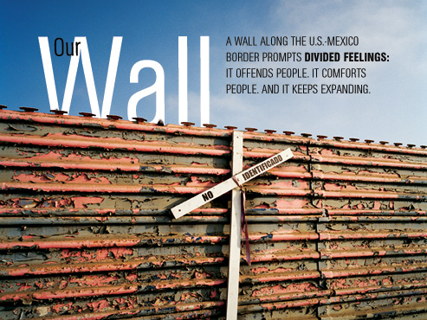
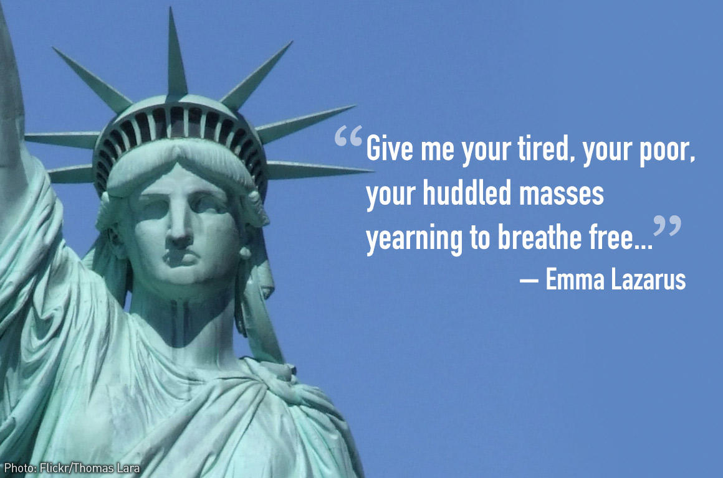
How We Respond

Slide 14
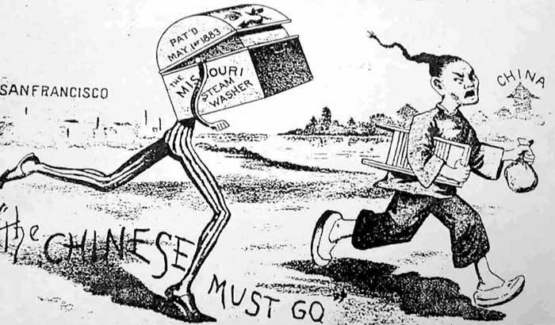
Restriction, Discrimination, and Rigid Racial/Ethnic Boundaries
1882-1943 Chinese Exclusion Act

Slide 15
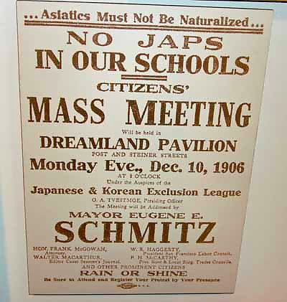
Restriction, Discrimination, and Rigid Racial/Ethnic Boundaries
1907 Gentleman’s Agreement (banned Japanese immigration)

Slide 16
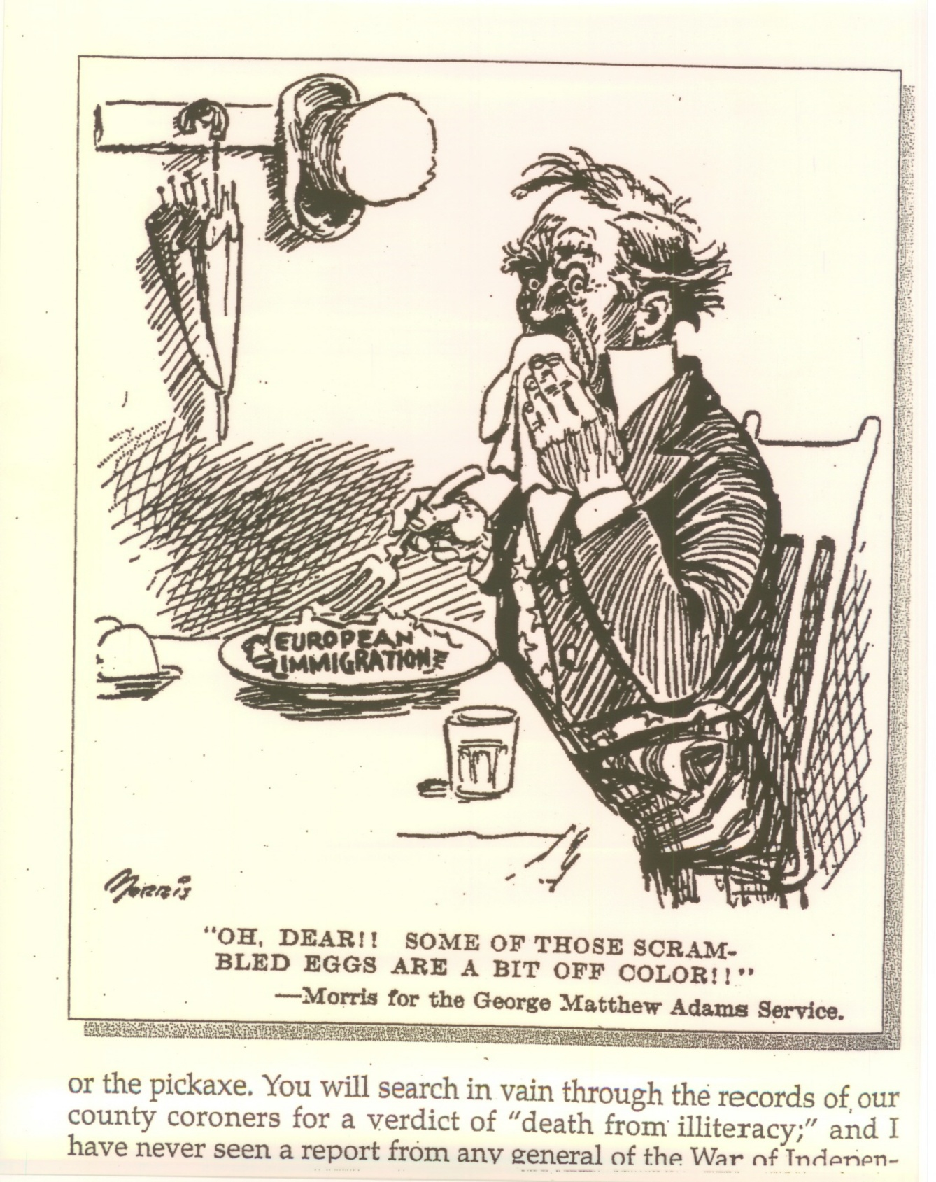
Restriction, Discrimination, and Rigid Racial/Ethnic Boundaries
1924 National Origins Act

Slide 17
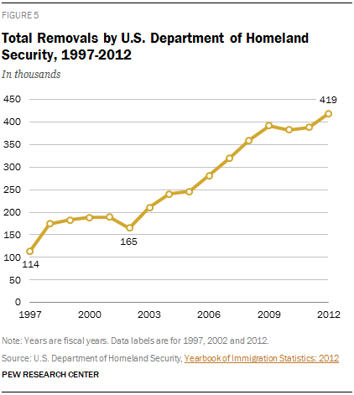
Deportation and Border Enforcement
Restriction, Discrimination, and Rigid Racial/Ethnic Boundaries

Slide 18
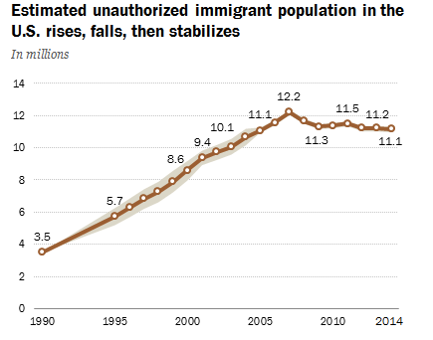
Source: Pew Research Center (http://www.pewresearch.org/fact-tank/2016/09/21/unauthorized-immigrant-population-stable-for-half-a-decade/)

Slide 19
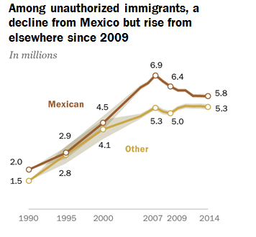
Source: Pew Research Center (http://www.pewhispanic.org/2016/09/20/overall-number-of-u-s-unauthorized-immigrants-holds-steady-since-2009/)

Slide 20
Civil Rights & Integration

Slide 21
Multiculturalism
Food and music (cultural omnivorism)
Intermarriage
Multiple and flexible identities

Slide 22
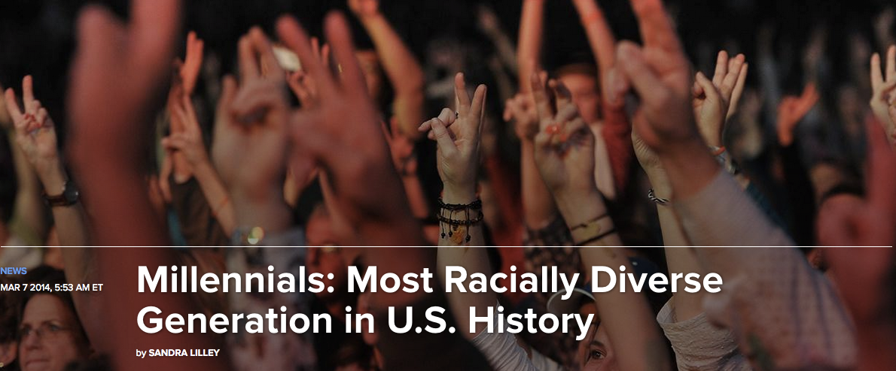
Generational Divides

Slide 23
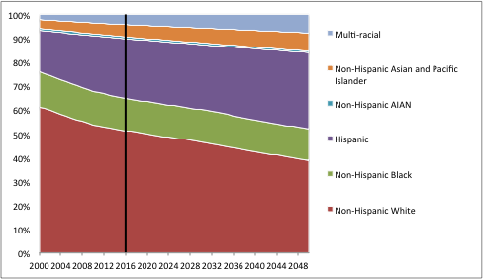
Future Generations of Children and Young Adults Will Be Even More Diverse

Slide 24
Discussion Questions
How diverse was the community you grew up in? http://www.usatoday.com/story/news/nation/2014/10/21/diversity-map/17657485/
What influences how people respond to growing racial and ethnic diversity?
Are racially-based restrictionist politics likely to continue in the future? Why or why not?

