Slide 1
The Trusteeship Concept for Sports Governing Boards
Stephen F. Ross
Professor of Law/ Director of Institute for Sports Law, Policy & Research
The Pennsylvania State University

Slide 2
U.S. Model of Sports Governance
Dis-integration
Highly successful closed professional sports leagues
Professional minor leagues contracting with major league clubs
Independently regulated college sports
Amateur sports: governing boards only regulate national team participation
Independently regulated primary and secondary school sports
Youth and adult recreation through local parks districts
Private elite youth leagues

Slide 3
Sports Governance Most Everywhere Else
Integrated under sports governing board
Regulates (to varying degrees) the elite commercial professional sports competition
(Usually) open leagues: promotion & relegation
NGB oversees all aspects of professional, representative, and amateur game

Slide 4
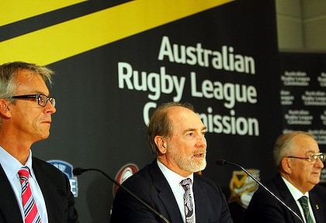
NGB Responsibilities
overseeing the commercial operation of elite professional club competitions;
developing talent for and managing international representative teams
funding grass-roots amateur clubs or organizations for purposes of:
youth recreation
development of elite young talent
adult recreation

Slide 5
Civil Society
Anglo-American development of sports through private association
Contrast Franco-German development of sport only with governmental approval, to serve military or other social ends
Reluctance of government to micro-manage
But sport now seen as serving public interest goals, rather than purely for benefit of “club members”

Slide 6
The Public Interest in Sports Governance
Public health strengthened through sports participation for youth and adults
Other social virtues of sports participation: teamwork, discipline, etc.
Social bonding
community identity
inclusion in multicultural context
Pride in success of representatives teams
Maximize consumer welfare by ensuring that professional spectator sports are operated in a way that maximizes output and renders output responsive to consumer preferences

Slide 7
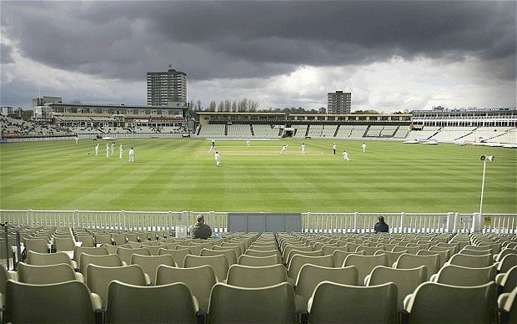
Sports Governance Contrary to the Public Interest
Corruption
Favouring particular stakeholders based on politics or logrolling
Pretext to permit spectator consumption of sport that is not supportable in the marketplace and does not serve other public-regarding goals

Slide 8
Key: Conflict-Free Governance
For commercial leagues, need residual claimant
NASCAR
AFL Commission
Australian Rugby League Commission
For NGBs, need directors free to operate in best interests of the sport
England Cricket Board
Club v Country battles in Six Nations rugby
Problems with the “good and the great”
no metric to judge balancing of legitimate interests
no way to assess principle v prejudice: T20 cricket

Slide 9
Key: Identified Beneficiaries on Whose Behalf Trustees can Act
Need proxy to allow balancing of various public interests
Proposed beneficiaries: individual youth and adult recreational participation in local clubs
Charge to NGB:
maximize revenues from commercially-appealing domestic club compensation, and use a percentage of gross revenue to fund grass-roots sports
prudent investment in representative teams results in both on-field success and off-field revenues, a percentage of which are used to fund grass-roots sports
“profits” taxed from professional leagues and national teams are used to provide subsidies and funding for youth and adult recreational sports beneficiaries

Slide 10
Two Kinds of Trust Obligations
In designing competitions to gain revenue, operate as a Private Trust would to maximize gain for beneficiaries
Design competitions to maximize revenues
Spending should be prudent based on a return on investment
In spending money thereby acquired on development, operate as a Charitable Trust would to maximize benefits

Slide 11
Obligations of Sports Trustees
clear breaches of duty
lack of informed decision making
self-dealing
adopting demonstrably pretextual policies that serve pseudo-beneficiaries
adopting demonstrably pretextual policies providing excessive rewards to incidental beneficiaries
breach of fair duty to all beneficiaries
analogy to US labour law Duty of Fair Representation?
reconciling competing interests
disclosure and transparency
unclear what Trust Law requires: is better analogy administrative law?
(???) scope of judicial review

Slide 12
Caveat: Requirements of Competition Law
Private entities are not empowered to restrain trade or abuse dominance because resulting monopoly profits will be spent on worthy causes
Requires legislation in US/UK/EU
Requires authorization in AU/NZ

Slide 13
Applying Concept to Recent Controversies
Kerry Packer and the Cricket Wars
NRL governance pre-ARL commission
England Cricket Board
Indian Premier League
US baseball

Slide 14
Questions and Comments

