Slide 1
Immigration Enforcement
January 2017

Slide 2
Who Can Be Deported?
Anyone who is not a US citizen
People who entered the US by crossing the border without papers
People who were previously deported and returned
People with legal status who have criminal convictions

Slide 3
Who Can Be Deported?
This includes:
Asylees and Refugees
Children and seniors
People with US citizen spouses or children
People who have lived in the US since childhood

Slide 4
Trigger Sites for Deportation
Raids of homes or workplaces
Travel: bus stations, train stations, airports, borders
Applying for or renewing immigration documents
Contact with the criminal system

Slide 5
ICE IN THE CRIMINAL SYSTEM

Slide 6
Criminal Alien Program
Funds ICE officers to review records and interrogate people at the site of a police stop, at police stations and in jails and prisons
Any police encounter can result in deportation, including brief encounters under stop-and-frisk, traffic stops etc., if police choose or are instructed to contact ICE
Police have access to immigration information through the national crime database, which they may use to detain or arrest a person

Slide 7
Criminal Alien Program
Most jurisdictions in PA allow ICE agents to interrogate people in local custody
People are not informed that these interrogations are voluntary and are not provided with attorneys during the interrogation
Some local law enforcement agencies will send biographic info or identification documents to ICE to review

Slide 8
Secure Communities and Priority Enforcement Program
Fingerprints of anyone arrested by local law enforcement are provided to ICE
ICE can request a hold to be placed on a person or to be notified of the person’s release

Slide 9
ICE Holds and Notifications
Also known as “detainers,” ICE holds are voluntary requests from ICE to local law enforcement to continue to detain a person who would otherwise be released
ICE has also instituted a notification program, requesting that local law enforcement take time and resources to notify ICE when a person will be released from custody

Slide 10
ICE Holds and Notifications
IT IS REQUESTED THAT YOU: Maintain custody of the subject for a period NOT TO EXCEED 48 HOURS, excluding Saturdays, Sundays, and holidays, beyond the time when the subject would have otherwise been released from your custody to allow DHS to take custody of the subject….As early as possible prior to the time you otherwise would release the subject, please notify DHS by calling________________during business hours or_______________after hours or in an emergency. If you cannot reach a DHS Official at these numbers, please contact the ICE Law Enforcement Support Center in Burlington, Vermont at: (802) 872-6020.

Slide 11
*Social Justice Lawyering Clinic at the Sheller Center for Social Justice, “A Changing Landscape,” March 2015

Slide 12
Example: Chicago Welcoming City Ordinance
(1) Unless an agency or agent is acting pursuant to a legitimate law enforcement purpose that is unrelated to the enforcement of a civil immigration law, no agency or agent shall:
A.
permit ICE agents access to a person being detained by, or in the custody of, the agency or agent;
B.
permit ICE agents use of agency facilities for investigative interviews or other investigative purpose; or
C.
while on duty, expend their time responding to ICE inquiries or communicating with ICE regarding a person’s custody status or release date.
*Chapter 2-173 of the Chicago Code

Slide 13
Deportation proceedings

Slide 14
Immigration Court
No right to an attorney
Only 37% have legal representation*
Individuals with representation are five times more likely to win their right to remain in the US*
No age restrictions
No capacity restrictions
*American Immigration Council, “Access to Counsel in Immigration Court,” September 2016

Slide 15
Immigration Detention
ICE may detain anyone in deportation proceedings at their discretion
Many people are not eligible for bond
There is no limit to the length of detention, so all immigration detention is indefinite

Slide 16
Lundy Khoy
Born in a Thai refugee camp after parents fled genocide in Cambodia
Immigrated to the US as a refugee when she was 1 year old
Stopped by police at her college when she was 19 and confessed to possessing tabs of ecstasy
Served three months and completed all probation
Ordered deported
In 2016, Lundy received a governor’s pardon in response to pressure from community groups
Lundy is still fighting her case!

Slide 17
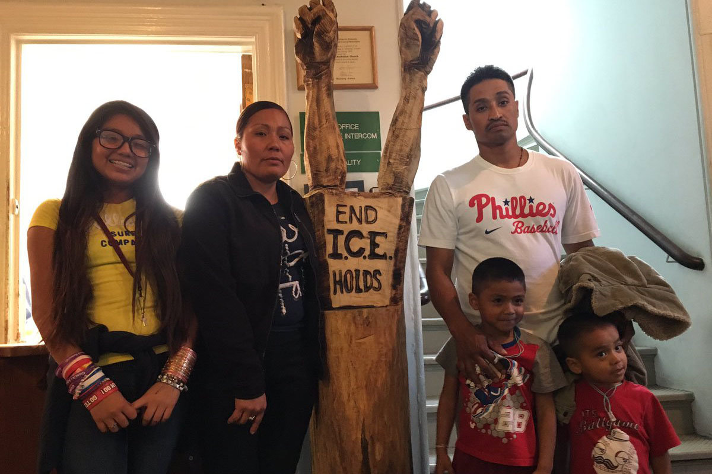
Javier Flores
Father of 3 US citizen children
Immigrated to the US in 1997
Previously deported and returned to be with his children
Survived an armed robbery in 2004 where he was stabbed and beaten
In 2015, ICE agents raided his home and placed him in a detention facility
After pressure from community organizations, ICE released Javier but pursued his deportation
Javier now lives in sanctuary at Arch Street United Methodist Church and continues to fight his case

