Slide 1
SPORTS LAW: Law and Strategy in the Globalized Sports Industry
Integrated and Dis-Integrated Governance and Fiduciary Duties\
https://psu.zoom.us/j/92030147398

Slide 2
Welcome
Introductions: NICKNAME, HOMETOWN, UNDERGRAD UNI, TEAMS YOU SUPPORT
administrative details
Canvas/ Required reading/ Syllabus
Assignments
Zoom and pandemic protocols
What is Sports Law?
specific statutes and regulations (e.g. Title IX, FIFA RSTP)
judicial application of broadly worded statutes in specific context of sports (antitrust, labor, IP)
arbitral or judicial interpretations of private agreements

Slide 3
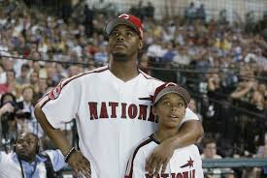
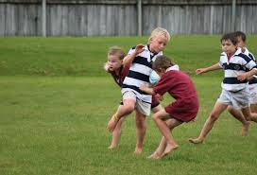
Fundamental difference in structure of sports governance: integration
How would an 11-year old American skilled at baseball progress until playing at the highest level?
How would an 11-year old in New Zealand skilled at rugby progress until playing for the All Blacks?

Slide 4
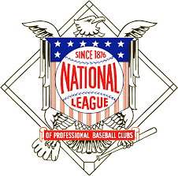
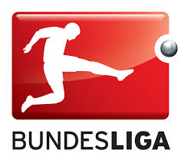
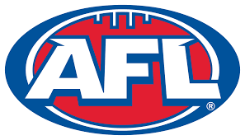
Governance Structures in the US and Globally
The National League as the model for American sports:
“dis-integrated” governance
Closed leagues
Purely commercial
The Football Association as the progenitor of the “European Model of Sports”
Integrated “pyramid” of governance
Promotion & Relegation
Club ownership model varies
Vertical separation
NASCAR/ BCCI
Australian Football League
Australian Rugby League Commission
US leagues are vertically AND horizontally integrated:
Club run league
Competition organizing
Participating in the competition

Slide 5
Role of government in sports governance
Statutes often confer authority to private bodies to act as the sole regulator of each sport
Spain [see Adv Intro 1.6]
Amateur Sports Act
English tradition: laissez faire and democratic participation
Australia pushes away with lure of government money for grass roots sports and stadia

Slide 6
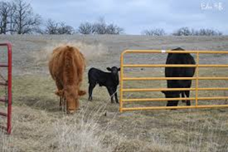
Economics of sport governance
Williamson: transaction cost minimization through club vetoes
Coase Theorem
No changes are Pareto optimal
“efficient” change is where gains to ‘winners’ > harms to ‘losers’
Efficient results will prevail in sports where everyone has good information and there are minimal bargaining costs
English football

Slide 7
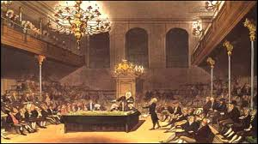
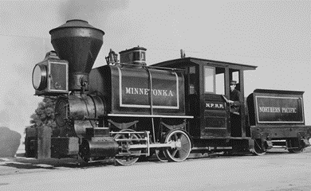
/ contd
Coase: Allocation of legal rights is critical to efficient results where imperfect information and high bargaining costs
Sports often involves these traits
Inability to quantify effect of change
Zero-sum concern if others benefit more
Public policy concerns where entities with market power can’t agree on best results
Trebilcock: need “transition mitigation strategies”

Slide 8
Applying Concepts to MLB Constitution
MLB Constitution
Broad delegation of power to Commissioner
Commissioner elected/re-elected with ¾ vote
Art V, sec. 2(a): majority vote for
Collective bargaining
Schedules
Actions relating to all-star games, post-season play
Playing or scoring rules (except DH)
Broadcast rights
Transfer to spouse or descendants
Art V, sec. 2(b): three-fourths vote for
Expansion or contraction
Sale or transfer of club ownership outside owners’ family
Relocation
Changes in divisional play
Revenue sharing
Termination of franchise
Amending MLB Constitution
Why would owners agree to a provision that allows 8 owners to block any major changes or innovations?
Notes:
MLB Const on Canvas

Slide 9
MLB Const Art II, Sec 4
Commissioner “shall take no action in the best interests of Baseball” regarding matters “any of the matters requiring a vote of the Clubs” [see prior slide], “provided, however, that nothing in this Section 4 shall limit the Commissioner's authority to act on any matter that involves the integrity of, or public confidence in, the national game of Baseball. Integrity shall include without limitation, as determined by the Commissioner, the ability of, and the public perception that, players and Clubs perform and compete at all times to the best of their abilities. Public confidence shall include without limitation the public perception, as determined by the Commissioner, that there is an appropriate level of long-term competitive balance among Clubs.”

Slide 10
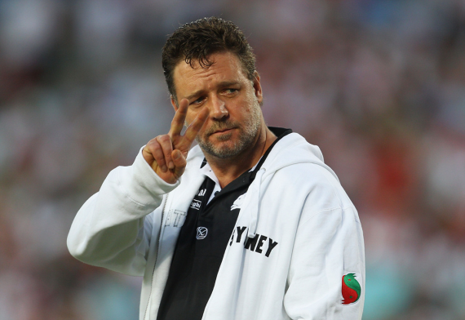
Illustration re Business Dynamics: Case Study of Russell Crowe’s Fleecies
Australia’s National Rugby League, like most US sports leagues, requires clubs to assign IP rights in club name and logos to the league office for marketing
Crowe wants to market fleecies for his South Sydney Rabbitohs
How should the NRL rules govern sales of team merchandise:
From the league’s perspective?
From a consumer/fan perspective?
From Crowe’s perspective?
From the perspective of the Wests Tigers, a league rival in a neighboring part of Sydney?
Is this rule [286] "one adopted more for the protection of individual league members from competition than to help the league?"

Slide 11
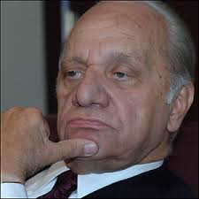
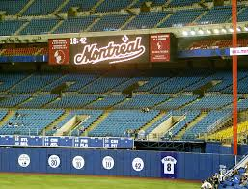
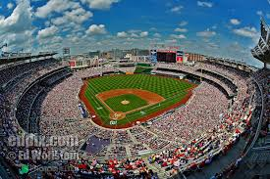
Illustration: relocation of Expos
How would you advise the Commissioner on moving team from Montreal to DC over Orioles objection?
What strategy should Angelos adopt?
Assuming relocation is demonstrably good for MLB, does Angelos have a fiduciary duty to support it?

Slide 12
American Needle
Two decisions challenged
NFL rule that clubs must assign exclusive rights to TM/logos to NFLP
NFLP decision to assign these rights only to Reebok
Legal issue is whether these decisions were made by “The NFL” or by “the owners of NFL clubs”
Basic principles
“eschew formalistic distinctions” for “consideration of how the parties ... actually operate” [p279]
distinguish between “a single aggressive entrepreneur” and “independent centers of decisionmaking”
Conclusion: decisions are agreements among owners, not by a “single entity” league: “each team’s decision reflects not only an interest in NFLP’s profits but also an interest in the team’s individual profits”
Notes:
Sealy: not a separate company but an instrument of individual manufacturers
Concl: [280a]: NFL actions are “guided and determined [by] separate corporate [club] consciousness”

Slide 13
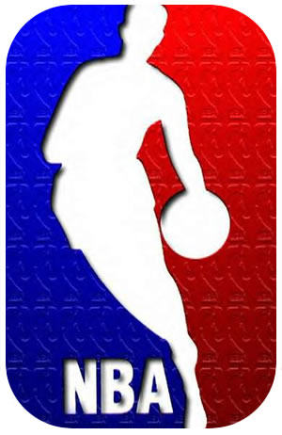
Was the Court correct?
Do you agree with Judge Williams in Raiders dissent and Judge Easterbrook in Bulls that "NBA Basketball" is one product from a single source, like McDonalds or GM?
Judge Cudahy in Bulls says focus is on whether league structure leads to inefficient management decisions
Agree that the club-run structure represents the “most efficient manner of reaching day-to-day decisions” for the league?
Why does Stevens, J. suggest that NFL might not act to maximize NFL profits?

Slide 14
Applying Needle
All MLB teams have granted exclusive internet rights to MLB Advanced Media LLP, a separate entity run by a BoD consisting of the MLB President, MLBAM President, and some (not all) owners
Suppose, in lieu of current direct sales via mlb.com, MLBAM agreed to make games available via internet exclusively on espn3.com (not available in certain areas where espn doesn’t have agreement w/ cable company):
Can this agreement be challenged under §1?

Slide 15
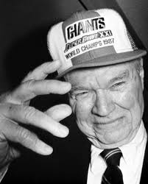
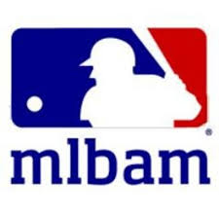
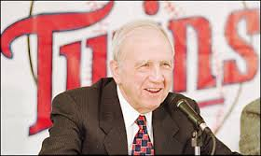
How to Deal with Inefficiencies in Club-Run Leagues
Identify winners and losers
Key: broadly define winners
Frame issues to maximize losers’ willingness to go along
Mara
MLBAM
Pohlad
Seek to remedy imperfect information
Devise cost-minimizing strategies to persuade losers
Ensure survival
Focus on reliance
Phase-out provisions for capitalized privileges
Puzzle: no lobbyists
Notes:
Winners include all possible stakeholders, including third parties (like sponsors, bookmakers, tv rights holders, etc.)

