Slide 1
PSU Law – Student Housing Options State College, PA
As of June 9th, 2014

Slide 2
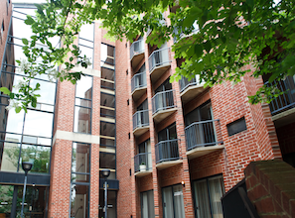
The Allenway
Features
Approx. 1.9 miles from Katz Building
10 minute drive to campus
Downtown, close to restaurants and shopping
Covered Parking
On-site Laundry Facility
No Pets
Atrium
On Site Management Company
24 Hour Maintenance Service
A/C
Refrigerator, dishwater, garbage disposal
Fully furnished rentals available
The Allenway
315 South Allen Street
State College PA 16801
814-238-0741
Apartment styles:
Studio/Efficiency - $685 - $780/mo.
One Bedroom - $830 - $925/mo.
Two Bedroom - $1235 - $1320/mo.
Included in the Monthly Rent
Water
Sewer
Trash
Extended Basic Cable
Not Included in the Monthly Rent
Electricity
Internet
http://www.allenway.net/

Slide 3
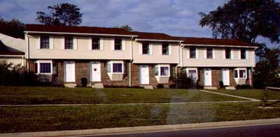
Bayfield Court
Features
Approx. 3.5 miles from Katz Building
10 minute drive to campus
Very quiet neighborhood
Walking distance to Weis grocery store/shopping center/State College YMCA
Private entrances
Private patio
Additional storage space
Fully equipped kitchen
Wall to wall carpet
A/C
Window coverings
Pet friendly
Bayfield Court
1500-1518 Blue Course Drive
State College, PA 16801 The Apartment Store Real Estate Group
(866) 746-3511
Housing styles:
Two bedroom, 2.5 bath
$980/month
Unfurnished
Included in the Monthly Rent
Water/sewer
Trash/snow removal
Parking
Not Included in the Monthly Rent
Electricity (heat)
Cable/internet
Sewer
http://www.apartmentstore.com/state-college/listing41.php

Slide 4
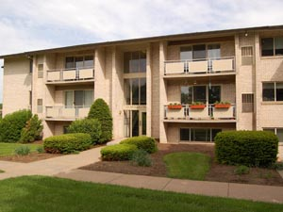
Briarwood Apartments
Features
Approx. 3.4 miles from Katz Building
Easy Access to Waupelani CATA Bus Line
10 Minute Drive to Campus
Walking Distance to Weis Market Shopping Center/State College YMCA
Fully Equipped Kitchens
24 Maintenance
On-Site Coin Operated Laundry Facilities
Patios and Balconies
Wall to wall carpeting
Pet-Friendly (extra pet fee applies)
Briarwood Apartments
679A Waupelani Drive
State College PA 16801
(866) 420-7555
Housing styles:
Efficiency - $904/month
1 BR Apartment - $1019/month
1 BR Apartment Large - $1059/month
2 BR Apartment - $1029-$1039/month
3 BR Apartment - $1408-$1458/month
2 BR Townhouse - $1215-$1255/month
2 BR Townhouse Large- $1199/month
3 BR Townhouse 2 Level - $1359-$1409/month
3 BR Townhouse 3 Level- $1459/month
4 Bedroom Townhouse - $1999/month
Included in the Monthly Rent
Water/sewer
Gas
Parking
Garbage/snow removal
Not Included in Monthly Rent
Electricity
Cable/internet
http://morgan-properties.com/morganlocations/PropertyDetail.asp?propertyID=9011

Slide 5
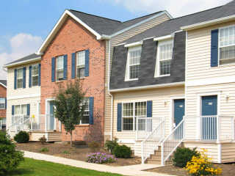
Copper Beach Townhomes
Features
Easy Access to Cata Bus Line
Easy Access to Red Link CATA Bus
Check with individual property for pet restrictions (requires deposit and monthly fee)
Copper Beech Townhomes
145 Northbrook Lane, Unit 101
State College, PA 16803
(814) 867- 2323
Northbrook Greens (Rent Calculated Per Person)
145 Northbrook Lane, State College, PA 16803 – Approx. 2.9 miles from Katz
1 Bedroom Apartment: Unfurnished/ Furnished - $980 - $959/mth
2 Bedroom Townhouse: Unfurnished/ Furnished - $685 - $695/mth
Each bedroom has a full private bathroom
Oak Hill (Rent Calculated Per Person)
130 Farmstead Lane, State College, PA 16803 – Approx. 3.3 miles from Katz
3 Bedroom Townhouses
All bedrooms have full private bathroom
$555 - $574/mth
Oakwood Avenue (Rent Calculated Per Person)
688 Oakwood Ave. State College, PA 16803 – Approx. 3.5 miles from Katz
Same layout as Oak Hill: Unfurnished/ Furnished
$555 - $575/mth
West Aaron Drive (Rent Calculated Per Person)
1003 W. Aaron Dr. State College, PA 16803 – Approx. 2.7 miles from Katz
Same layout at Oak Hill and Oakwood Drive
$554 - $565/mth
Included in the Monthly Rent
In unit washer and dryer
High speed internet/cable
Furnished and Unfurnished units available
Snow removal, garbage removal
Up to $20/mo. water/sewer allowance per person
Up to $30/mo. Electricity allowance per person
Not Included in the Monthly Rent
All other utilities
Parking $15/month/car
Additional parking $50 per car/per month
http://www.cbeech.com/statecollege.htm

Slide 6
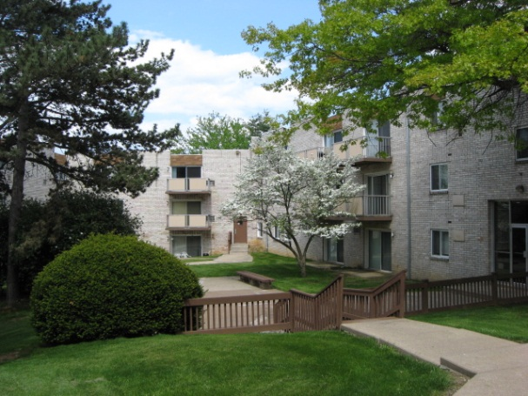
Executive House Apartments
Features
Approx. 2.9 miles from Katz Building
10 minute drive to campus
Walking distance to Weis grocery store/shopping center/State College YMCA
Accessible from Waupelani CATA bus route
Cat friendly (extra fees apply)
Landscaped courtyard
On-site laundry
A/C
Executive House Apartments
411 Waupelani Drive
State College, PA 16801 (814) 238-7211
Housing styles:
Apartment Styles:
1 Bedroom 1 Bath
$725/month
1 Bedroom Large 1 Bath
$765/month
2 Bedroom 1 Bath
$880/month
3 Bedroom 2 Bathroom
$1105/month
Included in the Monthly Rent
Heat
Water/sewer
Trash/snow removal
Expanded cable
Not Included in the Monthly Rent
Electricity
Internet
Parking $20/month
http://www.apartmentsstatecollege.com/property.php?id=46

Slide 7
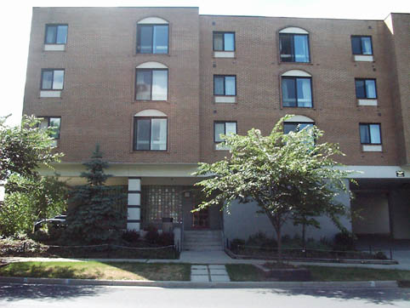
Fairmount East Apartments 2 Properties
Fairmount East I Apartments
235 E. Fairmount Avenue, State College, PA 16801 – Approx.. 2.9 miles from Katz
Studio apartments 1 Bath - $735 furnished/ $685 unfurnished
Amenities include on-site laundry, microwave, garbage disposal, wall to wall carpet, window coverings, A/C, patio
9-month leases available
Rent includes everything except:
Electricity/cable/internet/phone/parking
Parking is available $350 outside or $400 inside per semester
Fairmount East II Apartments
203 E. Fairmount Avenue, State College, PA 16801 – Approx.. 2.9 miles from Katz
1 Bedroom 1 Bath apartment - $1100/month
2 Bedroom apartment 2 Bath or 1 ½ Bath - $1860-$1944/month
Amenities include on-site laundry, microwave, garbage disposal, wall to wall carpet, window coverings, A/C, patio
9-month leases available
Rent includes everything except:
Electricity/cable/internet/phone/parking
Parking is available $350 outside or $400 inside per semester
Fairmount East Apartments Office
203 E. Fairmount Avenue State College, PA 16801 (814) 234-4188
24 hr. emergency maintenance
No pets
http://www.fairmounteastapts.com/

Slide 8
Fairmount East Apartments 3 Properties
West Hamilton Avenue
112 W. Hamilton Avenue, State College, PA
1 Bedroom unfurnished 1 Bath - $710/month
5 min. drive/10 min. walk to campus, on-site laundry, one covered parking spot included w/ rent.
Rent includes everything except: electricity, cable/internet/phone
Waring, Pugh, and McCormick (Exclusive to non-students or graduate students)
1 Bedroom - $730/month
1 Bedroom + Den - $830/month
5 minute drive / 10 minute walk to campus, on-site laundry, hardwood floors, accessible by CATA bus
Rent includes everything except: electricity, cable/phone/internet
Heat & Hot Water included
Parking is $150/semester
Waring, Pugh, and Crestmont Road Townhouses (Exclusive to non-students or graduate students)
3 Bedroom townhouse - $930/month
Waring and Pugh allows for 1 car, Cresmont allows for 2cars
Washer/dryer hook-ups, hardwood floors, accessible from CATA bus route, 5 minute drive/10 minute walk to campus
Fairmount East Apartments Office
203 E. Fairmount Avenue State College, PA 16801 (814) 234-4188
24 hr. emergency maintenance
No pets
http://www.fairmounteastapts.com/

Slide 9
Farmstead Lane Townhomes
Features
Approx. 3.3 miles from Katz Building
Very quiet neighborhood
10 minute drive to campus
Pet friendly (extra fee applies)
2 parking spots per house
A/C
Laundry hook-up or washer/dryer for $20/month
Fully equipped kitchens
Patio or Decks
Pets welcome with additional fees
Carpeting
Garage with Keyless Entry Pads
Farmstead Lane Townhomes
303 Farmstead Lane
State College, PA 16801 (814) 238-7211
Housing styles:
Townhome styles:
2 Bedroom
$1110-$1130/month
2 Bedroom w/ garage
$1255/month
Included in the Monthly Rent
Water/sewer
Trash/Snow removal
2 Free Parking Spaces
Not Included in the Monthly Rent
Electric
Gas
Cable/Internet
http://www.apartmentsstatecollege.com/property.php?id=48

Slide 10
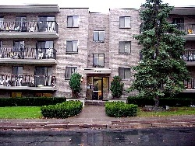
Garner Court
Features
Approx. 1.1 miles from Katz Building, 5 minute drive
Convenient downtown location
Perfect for single students who do not have a car
2 blocks from campus
Accessible from white loop CATA route
Fully furnished
24 hour maintenance
Fitness room
On-site laundry
No pets
Garner Court
228 S. Garner Street
State College, PA 16801 A.W. & Sons
(814) 237-0363
Housing styles:
Apartment Styles:
Studio
$822/month
2 Bedroom 1 Bathroom
$1,786-$2,110/month
3 Bedrooms 2 Bathrooms
$2,638-$2,698/month
Included in the Monthly Rent
Heat
A/C
Electricity
Water/Sewer
Trash/Snow removal
Not Included in the Monthly Rent
Cable/internet/phone
Parking is limited and $90/month
http://www.awandsons.com/apartments.asp?code=gc

Slide 11
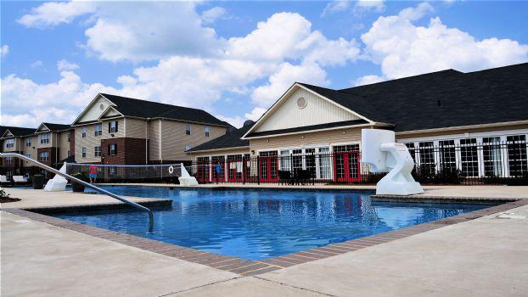
The Grove
Features
Approx. 3 miles from Katz Building, 5 minute drive
Individual leases for each room of the apartment
Private bedroom and private bathroom, walk-in closet
Full kitchen
Fully furnished with modern furniture
Volleyball/basketball courts
Resort-style pool
Fire pit and outdoor grills
Free coffee bistro and library with printing
24-hour gym
Tavern with billiards and games
Roommate matching service
The Grove
850 Toftrees Ave. State College, PA
(814) 954-2372
Housing styles:
Apartment Styles:
2 Bedroom, 2 Bath
3 Bedroom, 3 Bath
Included in the Monthly Rent
Water/Trash/Sewer
$25/mo electricity allowance per tenant
High Speed Internet
Premium Cable
Full size washer and dryer in each unit
CATA bus pass
Free parking
Not Included in the Monthly Rent
Electricity over the provided amount

Slide 12
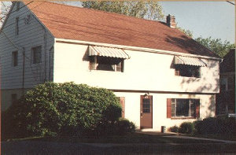
Hamilton House Apartments
Features
Approx. 1.7 miles from Katz Building
5 minute drive/10 minute walk to campus
Walking distance to Hamilton Shopping Center, including East Coast Fitness
Range/refrigerator
On-site laundry
Large windows
On-site parking $200/semester
No window coverings
No pets
Hamilton House Apartments
124-128 E. Hamilton Avenue State College, PA 16801 The Apartment Store Real Estate Group
(866) 746-3511
Included in the Monthly Rent
Heat (except unit #1 and 2)
Water/sewer
Trash/snow removal
Lawn maintenance
Not Included in the Monthly Rent
Electricity
Heat in Unit #1 and 2
Cable/internet
Parking - $200 per semester
Housing styles:
Apartment styles:
1 Bedroom unfurnished (lower level)
$766/month
1 Bedroom unfurnished (upper level)
$785/month
http://www.apartmentstore.com/state-college/listing46.php

Slide 13
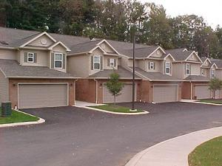
Hemmingway Place
Features
Approx. 2.3 miles from Katz
10 minute drive to campus
Easy Access to CATA Bus Route
Very private, quiet environment
Only graduate students allowed
In unit washer and dryer
Fully equipped kitchens
1 or 2 car garage
24 hour maintenance
Pets allowed $25/month + deposit
Hemmingway Place
1051 Teaberry Lane
State College PA 16803
814-308-9602
Housing styles:
Apartment and Townhouse styles:
2 Bedroom apartment
$1,145/month
2 Bedroom townhouse with 1 car garage
$1,435 - $1,485/month
3 Bedroom townhouse with 2 car garage
$1,655/month
Included in the Monthly Rent
Water
Sewer (buildings D & E)
Trash removal
Snow removal
Cable
Not Included in Monthly Rent
Electricity
Gas
Internet/phone
Sewer (buildings A, B & C)
http://www.hemmingwayplace.com/

Slide 14
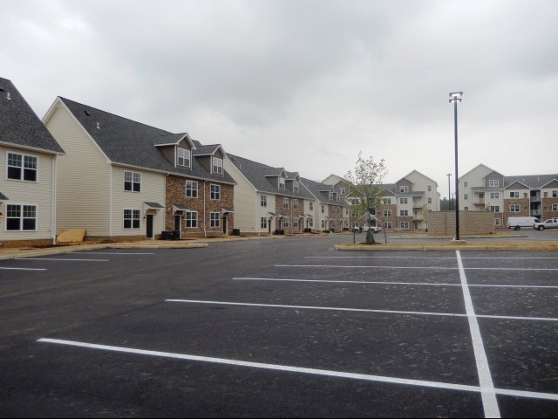
The Heights at State College
Features
Approx. 3.1 miles from Katz Building, 7 minute drive
Free parking
Along CATA Bus Route
Tanning Salon and Fitness Center
Fireside Lounge
Resort Style Pool
Individual leases
Private bedrooms and bathrooms
Individual climate control
Full furnished apartments
Full size W/D unit in each apartment
Cable and internet included
Private patio or balcony
Window coverings
The Heights at State College
201 Northwick Blvd. State College, PA
(814) 861-7100
www.heightsatstatecollege.com
Housing styles:
Apartment Styles:
2 Bedroom Apartment
$675/month
3 Bedroom, 3.5 Townhome
$635/month
3 Bedroom, 3.5 Townhome (II)
$645/month
4 Bedroom Apartment
$590/month
No Security Deposit

Slide 15
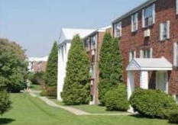
Lions Gate Apartments
Housing styles:
Apartment styles:
Studio efficiency 1 Bath - $660/month unfurnished or + $25/month furnished
1 Bedroom 1 Bath - $785/month unfurnished or + $80/month furnished
1 Bedroom with W/D 1 Bath - $810/month unfurnished or + $80/month furnished
1 Bedroom Deluxe 1 Bath - $865/month unfurnished or +80/month furnished
1 Bedroom Deluxe + Study - $910/month unfurnished or + $80/month furnished
2 Bedroom w/ W/D 1 Bath - $920/month unfurnished or + $100/month furnished
2 Bedroom w/ W/D and 2 AC 2 Bath - $1,015/month unfurnished or + $100/month furnished
2 Bedroom w/ W/D and 3 AC 2 Bath Luxury - $1,035/month unfurnished or +$100/month furnished
Lions Gate Apartments
424 Waupelani Drive State College, PA 16801 (814) 238-2600
Features
Approx. 3 miles from Katz Building
10 minute drive to campus/ Accessible from Waupelani CATA Bus route
Walking distance to Weis grocery store/shopping center and State College YMCA
On-site laundry facilities, tennis and basketball courts
Leases available for the year, 9.5 months, or fall semester
Dog: $30/per month; cat: $20/per month
Included in the Monthly Rent
Parking
Basic cable
Heat/Gas
Water/sewer
Trash/snow removal
Parking
Not Included in the Monthly Rent
Electricity
Expanded cable
Internet/phone ($25/month)
http://www.lionsgateapts.com/

Slide 16
Marion Place
Features
Approx. 1.9 miles from Katz
10 minute drive to campus
Downtown
Close to downtown shopping and restaurants
Easy Access to numerous CATA Bus Routes
Sliding glass doors and private balconies
Marble gas fire places
Key card entry
Washer/drier in each unit
Marion Place
135 East Nittany Avenue
State College PA 16801
814-238-0741
Atlas Realty Management 315 South Allen Street
State College, PA 16801
Included in the Monthly Rent
All inclusive rental rates
Not Included in Monthly Rent
Telephone
Housing styles:
Apartment styles:
1 Bedroom with optional home office
$1,455/mo.
1 Bedroom with fireplace and option home office (price N/A)
2 Bedroom, 2.5 bath corner unit with fireplace
$2,035/mo.
http://www.marionplace.com/marion.html

Slide 17
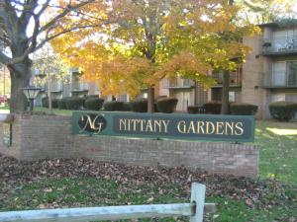
Nittany Garden Apartments
Features
Approx. 3.1 miles from Katz Building
10 minute drive to campus
Walking distance to Weis Grocery Store/Shopping center/State College YMCA
Right on Waupelani CATA Bus Route
A/C
Window coverings
On-site laundry
Fully-equipped kitchen
Swimming pool/play ground/balcony
On-site storage
Small pet friendly
Short term leases available for extra fee
Nittany Garden Apartments
445 Waupelani Drive State College, PA 16801 The Apartment Store
(866) 746-3511
Housing styles:
Efficiency Unfurnished
$774/month
1 Bedroom Furnished
$951-$970/month
2 Bedroom Unfurnished
$997-$1034/month
2 Bedroom Furnished
$1072-$1109/month
3 Bedroom Standard Unfurnished
$1082-$1159/month
3 Bedroom Standard Furnished
$1182-$1259/month
3 Bedroom (Large) Unfurnished
$1202-$1288/month
3 Bedroom (Large) Furnished
$1302-$1388/month
Included in the Monthly Rent
Parking
High speed internet or cable
Water
Trash/snow removal
Sewer
Not Included in the Monthly Rent
Electricity
Gas heat
http://www.apartmentstore.com/state-college/listing7.php

Slide 18
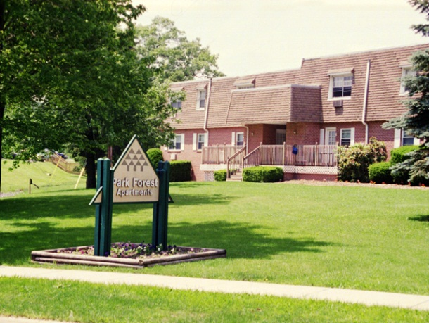
Park Forest Apartments
Features
Approx. 2.4 miles from Katz Building
Located just off N. Atherton Street
10 minute drive to campus
Accessible by Martin CATA bus route
Pet friendly (extra fees apply)
On-site laundry
Playground
A/C
Park Forest Apartments
901 West Aaron Drive
State College, PA 16803 (814) 238-7211
Housing styles:
Apartment Styles:
1 Bedroom 1 Bath
$705/month
2 Bedroom 1 ½ Bath
$890-$930/month
Included in the Monthly Rent
Heat
Gas
Water/sewer
Trash/snow removal
Basic Cable
1 Parking spot per bedroom
Not Included in the Monthly Rent
Electricity
Expanded cable/internet
http://www.apartmentsstatecollege.com/property.php?id=47

Slide 19
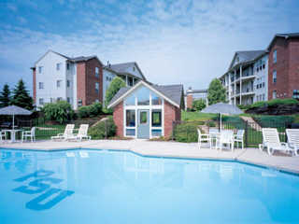
Parkway Plaza Apartments
Features
Approx. 2.5 miles from Katz Building, 10 minute drive to campus
Located on the Waupelani CATA bus route
Outdoor pool
Fitness center
Computer lab
Activities room
On-site laundry facilities
Parking $40/month per car
No pets
Parkway Plaza Apartments
1000 Plaza Drive
State College, PA 16801 (814) 238-3432
Housing styles:
Apartment Styles:
Studio
Unfurnished $735 - $745/month
1 Bedroom (small) 1 Bath
Unfurnished $795 - $800/month
1 Bedroom (large) 1 bath
Unfurnished $830 - $845/month
2 Bedroom 1 Bath
Unfurnished $480 - $490/month (per person)
2 Bedroom 2 Bath
Unfurnished $570 - $575/month (per person)
3 Bedroom 2 Bath
Unfurnished $490 - $510/month (per person)
Included in the Monthly Rent
Electricity
Water/sewer
Trash/snow removal
Internet/cable
Not Included in the Monthly Rent
Phone
$30 per space per month
$60 per carport per month
http://www.parkwayplaza.com/

Slide 20
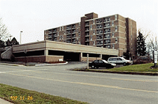
Pepper Mill Condominiums
Features
Approx. 1.9 miles from Katz Building
5 minute drive/10 minute walk to campus
Walking distance to Hamilton Shopping Center including East Coast Fitness
Located on Waupelani CATA Bus Route
On-site residence manager
On-site laundry facilities (in basement)
No pets
Pepper Mill Condominiums
710 South Atherton Street
State College, PA 16801-4656
(814) 404-2689
Included in the Monthly Rent
All utilities included (except phone/cable/internet)
Parking
Not Included in the Monthly Rent
Phone
Cable
Internet
Housing styles:
Apartment styles:
Studio unfurnished - $800/month
1 Bedroom unfurnished $845/month

Slide 21
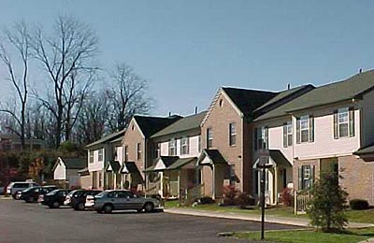
Pheasant Glen
Features
Affordable family housing
3 and 4 bedroom apartments
Located just off N. Atherton Street.
10 minute drive to campus
Close proximity to Vairo CATA Bus Route
A/C
Fully equipped kitchens
Some garage and covered parking
Outdoor play area and bike path
Window coverings
24 hour emergency maintenance
Private patios
Wall to wall carpeting
Washer/dryer optional
No pets
Pheasant Glen
446 Blue Course Drive
State College, PA 16803
814-235-1377
Housing styles:
3 Bedroom 1 and ½ Bath or 2 and ½ Bath
$995/month
3 Bedroom and 1 Bath
$1147/month
4 Bedroom 2 Bath
$1,095/month
Included in the Monthly Rent
Water
Sewer
Trash/Snow removal
Not Included in Monthly Rent
Electricity
Gas
Cable
Phone
http://www.apartmentstore.com/state-college/listing106.php

Slide 22
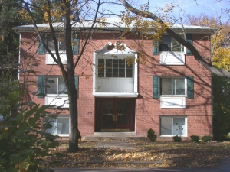
Prospect Avenue Apartments
Features
Approx. 2.1 miles from Katz Building
10 minute walk/ 2 minute drive to campus
Ideal for single students
Walking distance to downtown State College
On-site parking available $200/semester
Range/refrigerator
On-site laundry
Large windows
No pets
Prospect Avenue Apartments
219 E. Prospect Ave State College, PA 16801
The Apartment Store Real Estate Group
866-746-3511
Included in the Monthly Rent
Water
Gas
Sewer
Trash/snow removal
Lawn maintenance
Not Included in the Monthly Rent
Electricity
Cable/internet
Parking
Housing styles:
Apartment styles:
Small unfurnished efficiency
$487/month
Regular unfurnished efficiency
$745/month
1 Bedroom unfurnished
$873/month
http://www.apartmentstore.com/state-college/listing49.php

Slide 23
The Retreat
Features:
Approx. 3.5 miles from Katz Building, 10 minute drive
Cottage-style living with private bedrooms and bathrooms
Cardio Space/Strength Center
Clubhouse
Game room, golf simulator
Pet friendly (includes additional security deposit)
Pool
Racquetball, Bocce Ball, San Volleyball Court
Sauna/Spa/Salon/Tanning
Wifi Internet Access
Full kitchen
Faux wood flooring in living room and kitchen
Full size washer and drying in each cottage
The Retreat
300 Waupelani Drive
State College, PA 16801
(814) 231-0871
Housing Options:
5 BR/5Bath: $705/person/month
5 BR/5.5 Bath: $730/person/month
4 BR/4Bath: $725/person/month
4 BR/4.5 Bath: $755/person/month
3 BR/3 Bath: $790/person/month
2 BR/2.5 Bath: $915/person/month
Included in Monthly Rent:
High speed internet
Basic cable
Pest control
Trash
Access to all Retreat amenities
Parking
Not Included in Monthly Rent:
Electricity
Gas
http://www.retreatstatecollege.com/index.php/prop/home

Slide 24
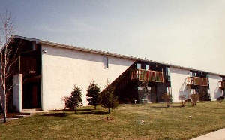
Sundown Apartments
Features
Approx. 3.3 miles from Katz
10 minute drive to campus
Right on Waupelani CATA Bus Route
Great for single students
Very quiet neighborhood
Across the street from State College YMCA
Either patio or balcony
Window coverings
Fully equipped kitchens
Wall to wall carpeting
A/C
On-site Laundry
No pets
Sundown Apartments
720 Stratford Drive State College, PA 16801 The Apartment Store Real Estate Group
(800) 553-2539
Housing styles:
1 Apartment Style
1 Bedroom Unfurnished
$779/month
Included in the Monthly Rent
Water/Sewer
Trash/Snow removal
Parking
Lawn Maintenance
Not Included in the Monthly Rent
Electricity
Heat/hot water
Cable/internet
http://www.apartmentstore.com/state-college/listing50.php

Slide 25
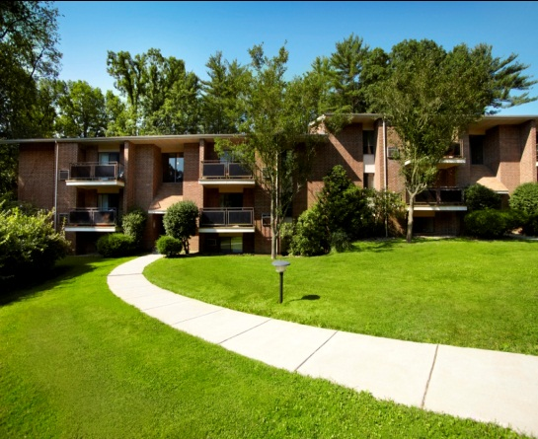
Toftrees
Features
Approx. 3.2 miles from Katz Building
8 minute drive to campus
Properties Include: Cricklewood, Parkgate, Hillside, Squirrel Run, Fox Run, and Wildrige
Quiet Location near Toftrees Golf Course
Fireplaces Available
Whirlpool Tub Available
Washer/Dryer in Select Units
Pets Welcome (additional fees apply)
Toftrees
501 Toftrees Ave., Suite 102
State College, PA 16802 (814) 237-5881
(888)-254-1255
Housing styles:
Apartment styles:
Studio - $753 - $886/month
1 Bed/ 1 Bath - $845-$1073/month
2 Bed/ 1 Bath - $870-$1050/month
2 Bed/ 1.5 Bath - $958-$1098/month
2 Bed/ 2 Bath - $1073-$1268/month
3 Bed/ 1.5 Bath- $999-$1186/month
Included in the Monthly Rent
Water/Sewer
Trash
24 Hour Emergency Maintenance
Not Included in the Monthly Rent
Electricity
Cable
Phone
Internet
http://locations.rentberger.com/toftrees/

Slide 26
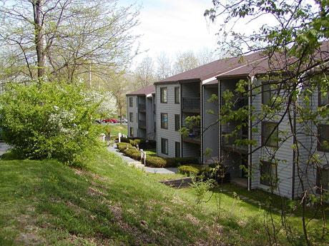
Toftrees Apartments
Features
Approx. 3 miles from Katz Building
Easy Access to Toftrees CATA Bus Line
10 Minute Drive to Campus
Quiet environment
Spacious rooms, enclosed patios, fully equipped kitchens, washer and dryer connections, pet-friendly.
Need Pet Approval
Walking trials
Toftrees Apartments
701 Cricklewood Drive
State College, PA 16803
814-237-5598
Housing styles:
Housing styles:
Single Family Townhomes - Cooper’s Pond
2 Bedroom 1 ½ Bath - $1,240/month
3 Bedroom 1 ½ Bath -$1,285/month
3 Bedroom 2 ½ Bath -$1,495/month
3 Bedroom 2 Bath - $1,515/month
Single Student Apartments – Turtle Creek
Studio - $835/month
1 Bedroom 1 Bath - $1,130/month
2 Bedroom 1 or 1 ½ Bath -$1,200/month
3 Bedroom 1 ½ Bath - $1,470/month
Single Student Housing:
4 Bedroom 2 Bath Suites - $750/student/month
Included in the Monthly Rent
Heat
Water
Garbage Removal
Snow Removal
Parking
Most buildings include all utilities. There are also some units with a washer and dryer for an additional $14/month.
Not Included in Monthly Rent
Electricity
Cable/internet
http://www.toftreesapartments.com/

Slide 27
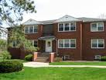
Towneview Apartments
Features
Approx. 2.8 miles from Katz Building
10 minute drive to campus
Quiet neighborhood
Accessible from CATA bus route
Fully equipped kitchens
On-site laundry
CATA bus pass $10/month
Townview Apartments
200 Bradley Avenue
State College, PA 16801 (814) 238-7211
Housing styles:
Apartment styles:
1 Bedroom
$700-$775 unfurnished or
$730-$785/month furnished
1 Bedroom Full Kitchen 1 Bath
$775/month unfurnished or $805/month furnished
2 Bedroom 1 Bath
$840-$905/ month unfurnished or $870 -
$1,085/month furnished
3 Bedroom 1 ½ Bath
$1,145/month unfurnished up to $1,335/month
furnished
Included in the Monthly Rent
Heat (All units except 2 Bedroom Loft and 3 Bedroom 2 Level)
Water/sewer
Gas
Trash/snow removal
Expanded cable
Not Included in the Monthly Rent
Electricity
Internet
On-site parking $40/month
http://www.apartmentsstatecollege.com/property.php?id=43

Slide 28
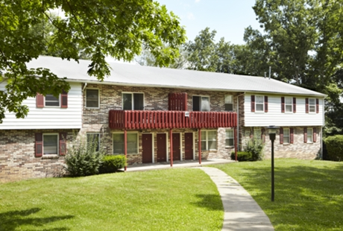
Vairo Village Apartments
Features
Approx. 3.2 miles from Katz Building
10 minute drive to campus
Access to Vairo CATA Bus Route
Very quiet environment
Picnic Area
On-site laundry
Wall to wall carpeting
24 hour maintenance
No pets
Vairo Village Apartments
10 Vairo Boulevard
State College, PA 16803 (877) 300-1464
Included in the Monthly Rent
Basic cable
Water/sewer
Trash/snow removal
Parking
Fitness center
Rent includes CATA Bus Pass
Not Included in the Monthly Rent
Electricity or gas (depends on what the apartment uses)
Expanded cable/internet/phone
Housing styles:
Apartment styles:
Studio Efficiency - $645-$795/month
1 Bedroom 1 Bath - $710-$850/month
2 Bedroom 1 Bath - $860-$1,095/month
3 Bedroom 2 Bath - $080-$1,565/month
http://locations.rentberger.com/vairovillage/

Slide 29
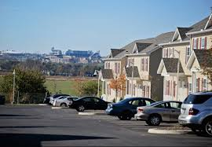
The Villas
Features:
Approx. 4.3 miles from Katz Building, about 9 minute drive
Clubhouse
Pool, fire pit, pool tables, volleyball court, café, gym
TV Lounge
24 hour emergency maintenance
Fireplace
Cable/satellite TV
Free internet
Balcony/porch
Flat screen TV in living room provided
CATA bus pass
Free parking
Washer and dryer in unit
Furnished or unfurnished available
Pet friendly
*certain floor plans may have different amenities depending on when they were updated, what building they’re in, etc. Call for tour/availability
The Villas at Happy Valley
1335 Dreibelbis Street State College, Pa 16801
(814) 272-1422
Housing Options:
1 BR/ 1 Bath- $550/month
3 BR/3.5 Bath- $595/person/month
*prices may vary based on furnished/unfurnished options

Slide 30
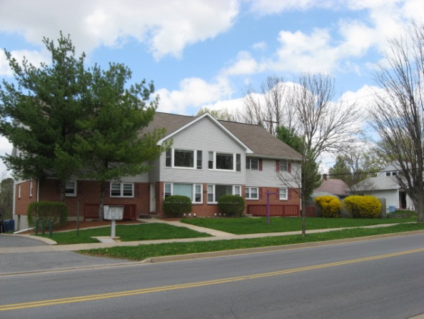
Waupelani Lofts
Features
Approx. 2.6 miles from Katz Building
10 minute drive to campus
Walking distance to Weis grocery store/shopping center/State College YMCA
Accessible from Waupelani CATA bus route
Fully furnished
Washer and Dryer included in each apartment
Fully equipped kitchens
Wall to wall carpeting
CATA bus pass $10/month
Waupelani Lofts
219 Waupelani Drive
State College, PA 16801 (814) 238-7211
Housing styles:
Apartment styles:
4 Bedroom 2 Bath Loft
$1,590/month
4 Bedroom 2 Bath 1 level
$1,760/month
5 Bedroom 2 Bath
$12,055/month
5 Bedroom 2 Bath + Study
$1,965/month
5 Bedroom 2 Bath + Large Study
$2,090/month
7 Bedroom 2 Bath
$2,620/month
Included in the Monthly Rent
Water/sewer
Trash/Snow removal
Expanded Cable
Not Included in the Monthly Rent
Electricity
Heat
Internet
On-site parking $45/month
http://www.apartmentsstatecollege.com/property.php?id=44

Slide 31
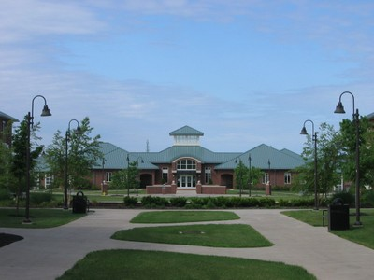
White Course Graduate Apartments (On Campus)
White Course Graduate Apartments
814-865-7501
Features
Approx. 1.7 miles from Katz Building
On-Campus Location (West Campus)
Walking Distance to Katz Building and Downtown State College
Easy Access to Red Link CATA Bus
Complete a Housing Application through PSU
No Pets
Housing styles:
1 Bedroom 1 Bath Apartment
$1030/month
2 Bedroom 1 Bath Townhouse
$1170 /month
3 Bedroom 1 Bath Townhouse
$1315/month
3 Bedroom 2 Bath Townhouse
$1330/month
Single Student Housing:
4 Bedroom 2 Bath Suites
$815/student/month
Included in the Monthly Rent
Cable/Internet/Telephone Access
Electricity, Heat, AC
Water
Garbage/Recycling
Snow removal
Parking
In-Unit Washer/Dryer
http://www.hfs.psu.edu/housing/graduates/whitecourse/

Slide 32
Additional Resources
www.apartments.com > Pennsylvania > Central Pennsylvania > Centre County > State College
http://www.collegian.psu.edu/classads/
www.craigslist.org > Pennsylvania > State College > Housing
http://law.psu.edu/the_penn_state_law_experience/student_life/campus_living/housing
Nevins Real Estate Management
214 South Allen Street
State College, PA16801
(814) 238-3153
Associated Realty Property Management
456 East Beaver Avenue
State College, PA 16801
(814) 231-3333
GN Associates
119 South Burrows Street
State College, PA 16801
(814) 238-1878
Additional Rental Companies
Kissinger Bigatel & Brower Realtors
2300 South Atherton Street
State College, PA 16801
(814) 234-4000
&
1612 North Atherton Street
State College, PA 16803
(814) 238-8080
Continental Realty
300 South Allen Street State College, PA 16801-4841 (814) 238-1598

